Slide 1
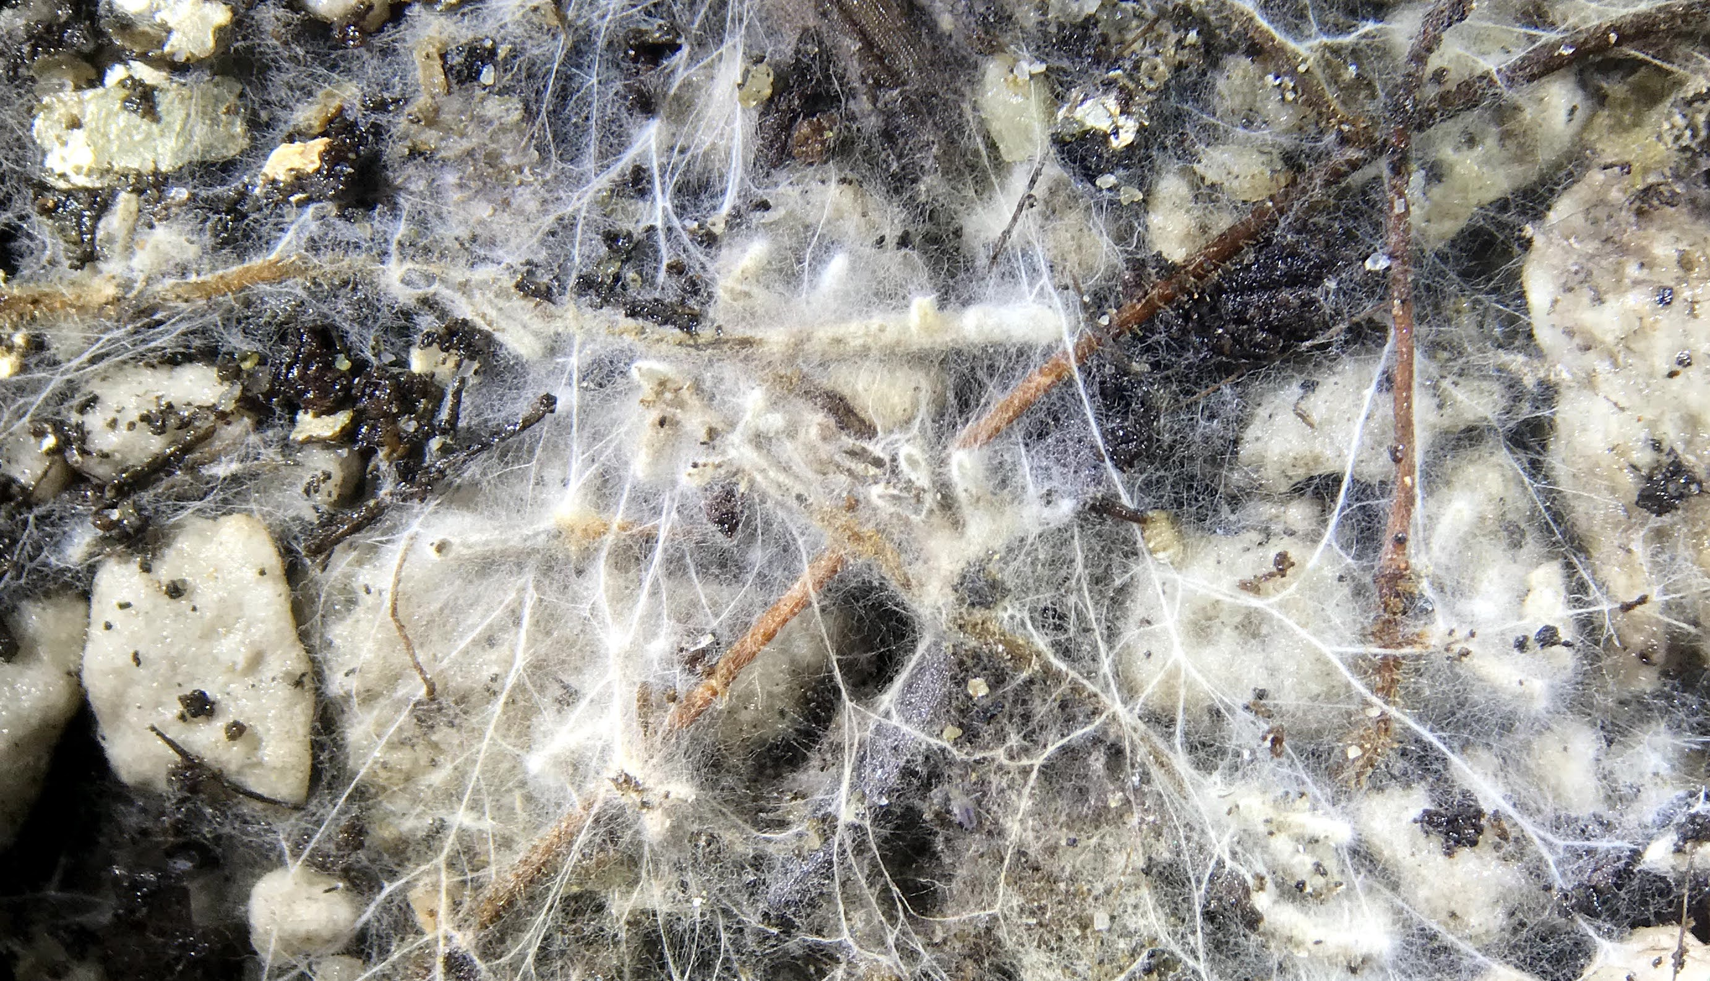
A symbiotic spectrum
How do ectomycorrhizal fungi affect tree seedling growth and drought tolerance?
Laura Bogar – lbogar@ucsb.edu/lmbogar@ucdavis.edu

Slide 2

Goals
Introduce ectomycorrhizas as key player in tree/environment interactions.
Spark conversations about methods, experiments, approaches that could help connect symbiosis and tree drought physiology.

Slide 3
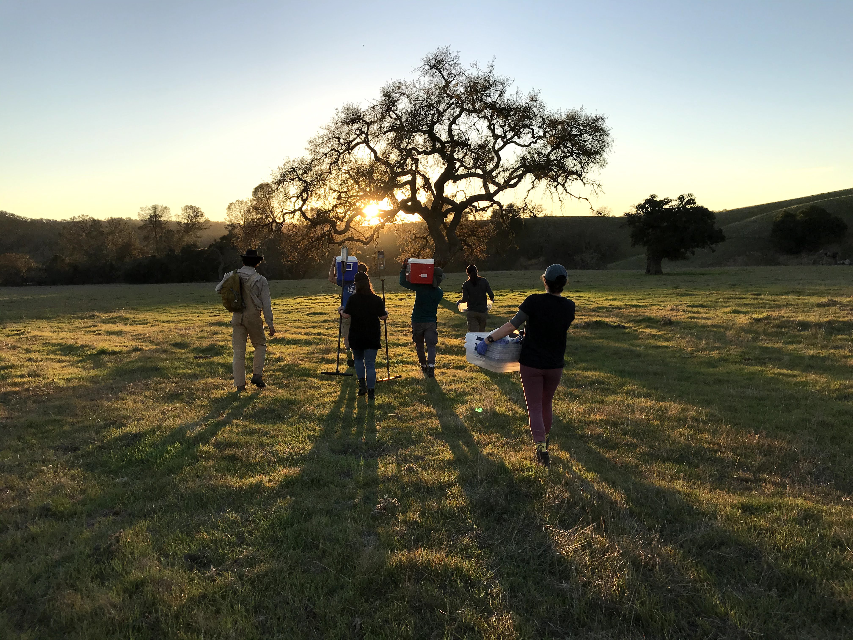





Acknowledgements
Collaborators and mentors: Holly Moeller, Kabir Peay, Tadashi Fukami, Mary Beth Mudgett, Peter Vitousek
High school, undergraduate, and graduate researchers: Drake Johnson, Anna Yang, Julia Gaudio, Alexandra Bernard, Natalie Francis, Caroline Blythe, Arvie Violette, Alex Smith, Oceana Tavasieff, Gabe Runte, Ronja Keeley
Outside collaborators: Jim Moran and Curtis Larimer (DOE); Annegret Kohler (INRA); Ted Raab, Jen Johnson, Joe Berry, Ari Kornfeld (Carnegie Institution)
GRFP, DDIG, PRFB
Notes:
Acknowledge: Collaborators (advisors, mentors), outside collaborators, mentees
Show the breadth of your collaborative science and ability to mentor new trainees
Holly suggests no animation, acknowledge people by category
You'll hear more about specific people at different parts
Funding: likes logos better (as previous version)

Slide 4
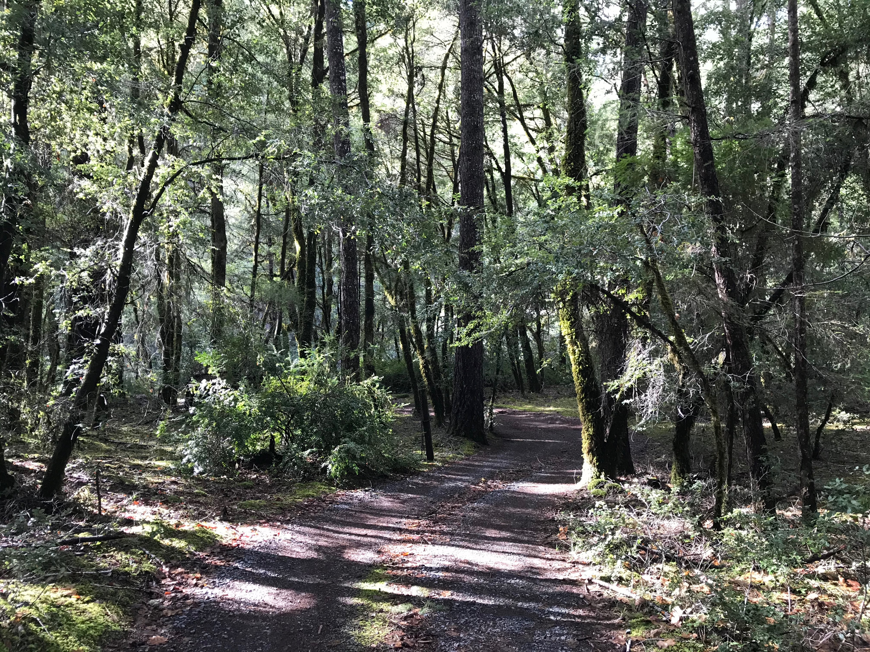
Plants and fungi: an essential symbiotic system

Slide 5
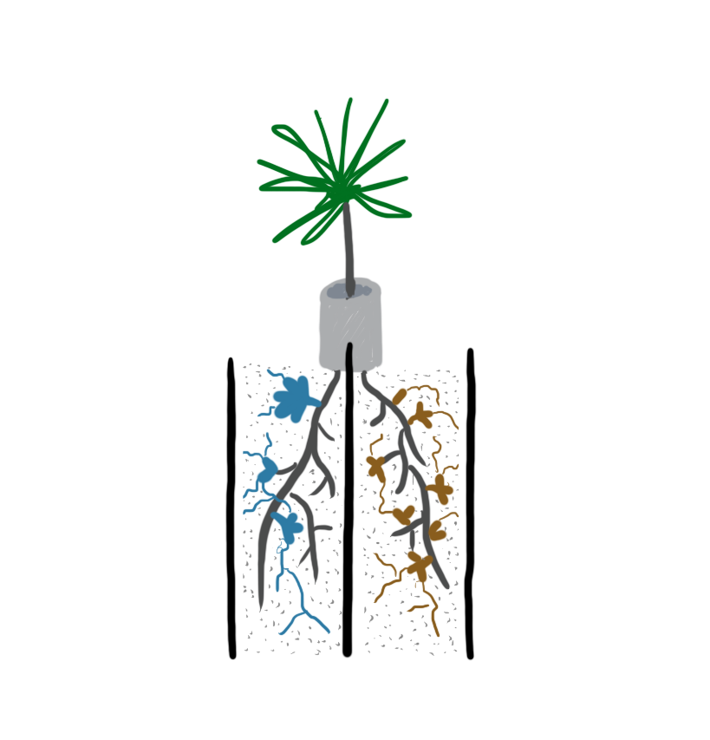

Using microscale tools to understand macroscale outcomes in plant symbiosis
Molecules
Individuals
Communities
Notes:
To study cryptic organisms like fungi, we often need molecular tools to get at larger-scale questions. This allows us to bridge several levels of organization at once!

Slide 6
Ectomycorrhizal plants dominate forests
Notes:
Essential for 60% of tree stems in the world

Slide 7


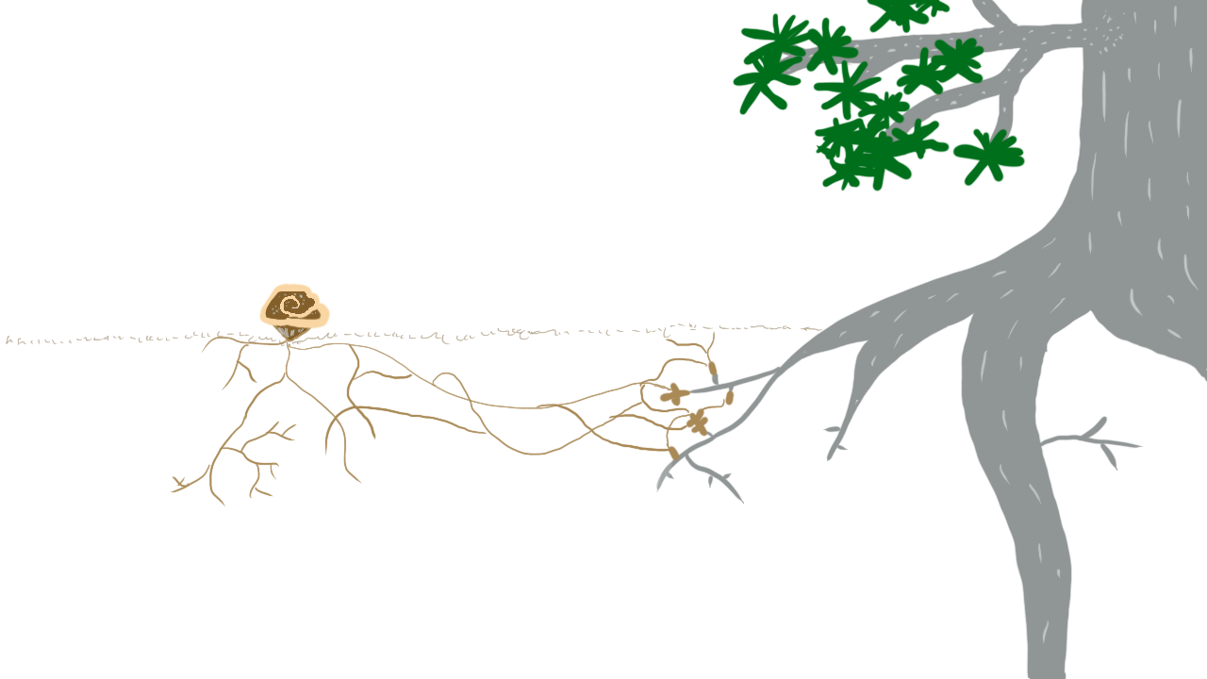
Obligate resource exchange
C
N
Notes:
Using their protein toolkits, fungi and plants can exchange resources. In the cooperative relationships that I study, plants take energy-rich carbon molecules that they’ve made through photosynthesis and send them down to the fungi on their roots. The fungi can use this carbon and energy to build fungal tissues. In exchange, the fungi extract nitrogen and other resources from the soil, sending this back to the plant. The plant needs nitrogen to grow, since it’s a crucial part of making proteins and DNA. This is {click} obligate resource exchange: Neither the plant nor the fungus can survive if it doesn’t have one or several partners to trade resources with.
Now, all of this resource exchange happens at the place where the fungus meets the root. I’d like to take a minute to introduce you to this structure. It’s called… {click}

Slide 8
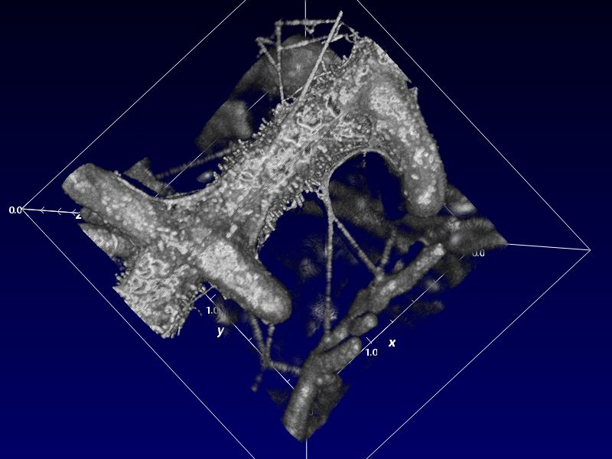
Ectomycorrhizas extend the plant’s root system at the microscale
Optical CT image (Quercus agrifolia with Thelephora terrestris) captured by Bogar, Larimer, Moran (2019)
Notes:
So, to really understand what’s driving the patterns we see at the macroscale, we really need to understand what happens at the molecular level when a hypha meets a root, and in the micron-scale soil pores where hyphae take up nutrients and compete with each other.
Quercus agrifolia ectomycorrhizas (fungus: Thelephora terrestris)
Optical Coherence Tomography image captured at Pacific Northwest National Labs

Slide 9
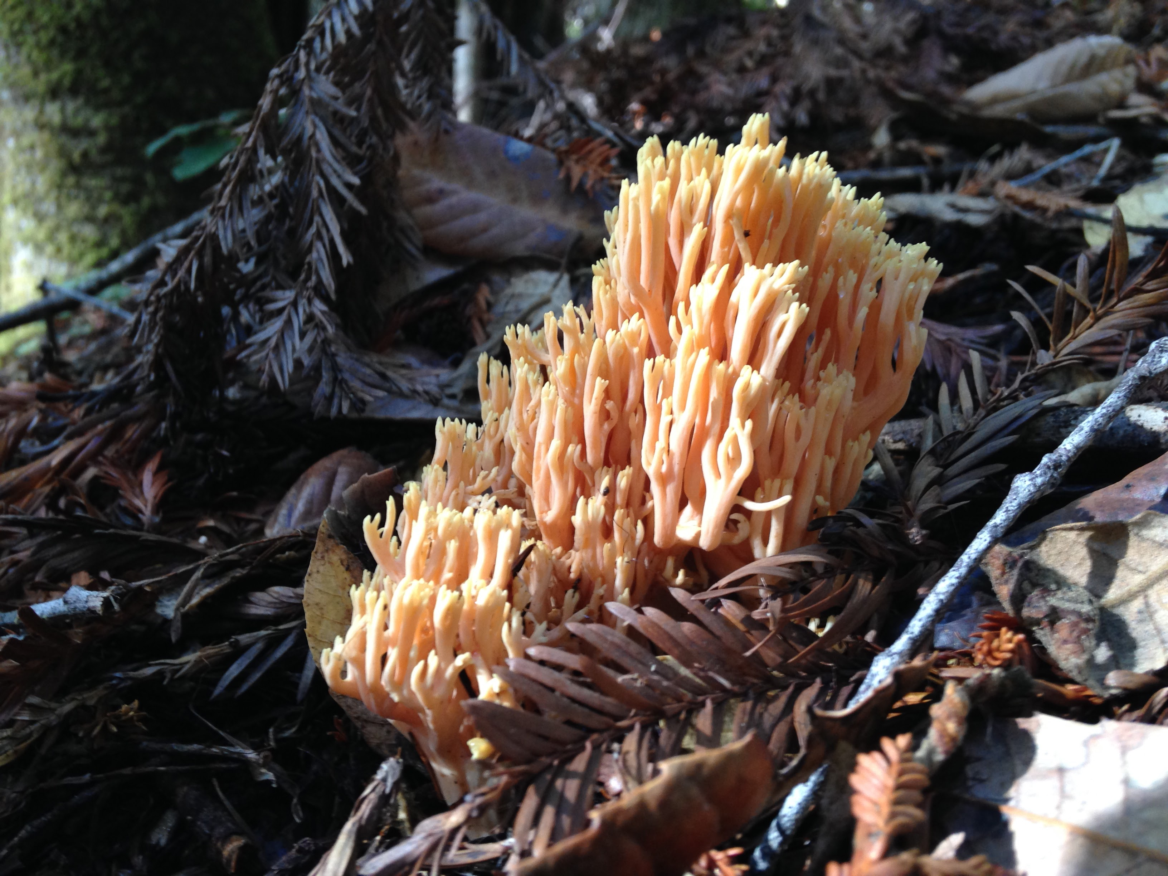
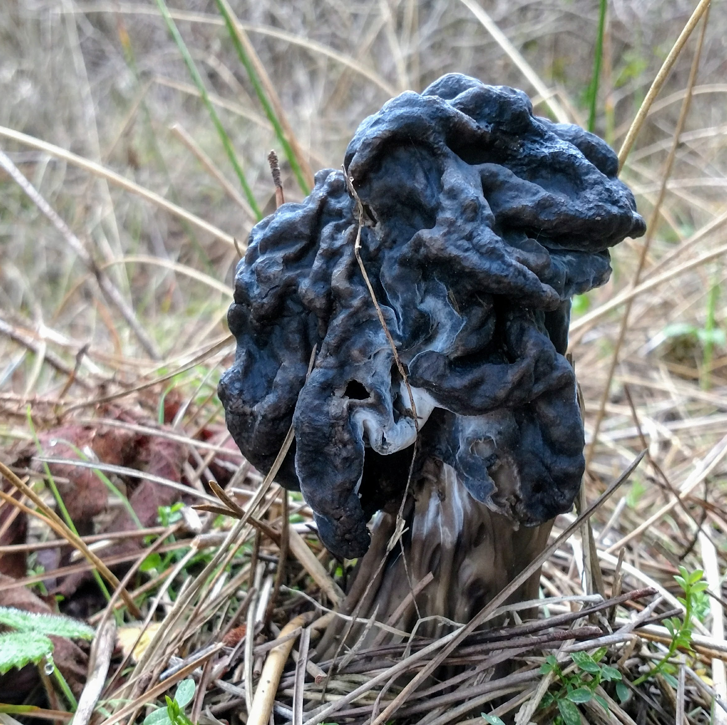
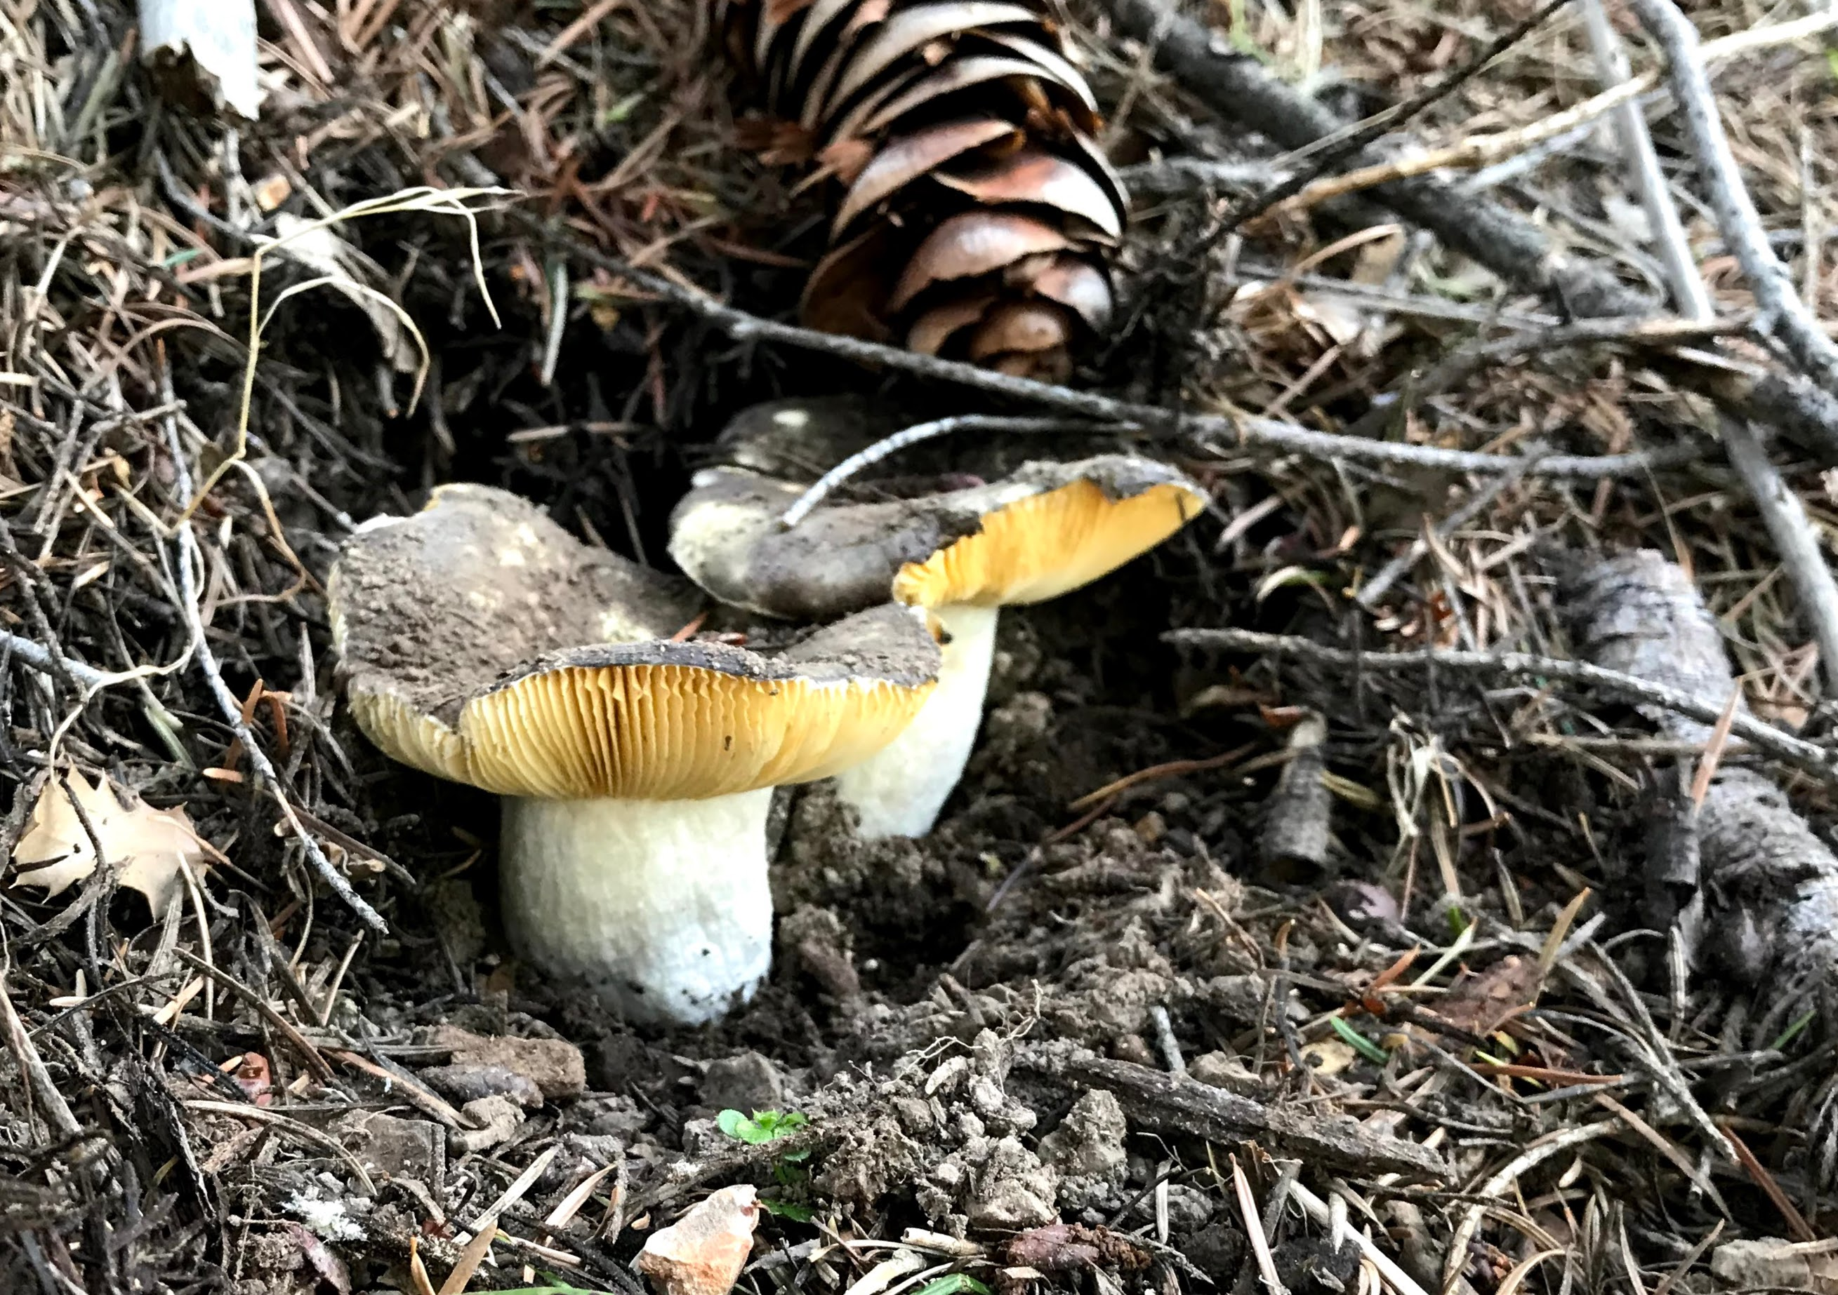
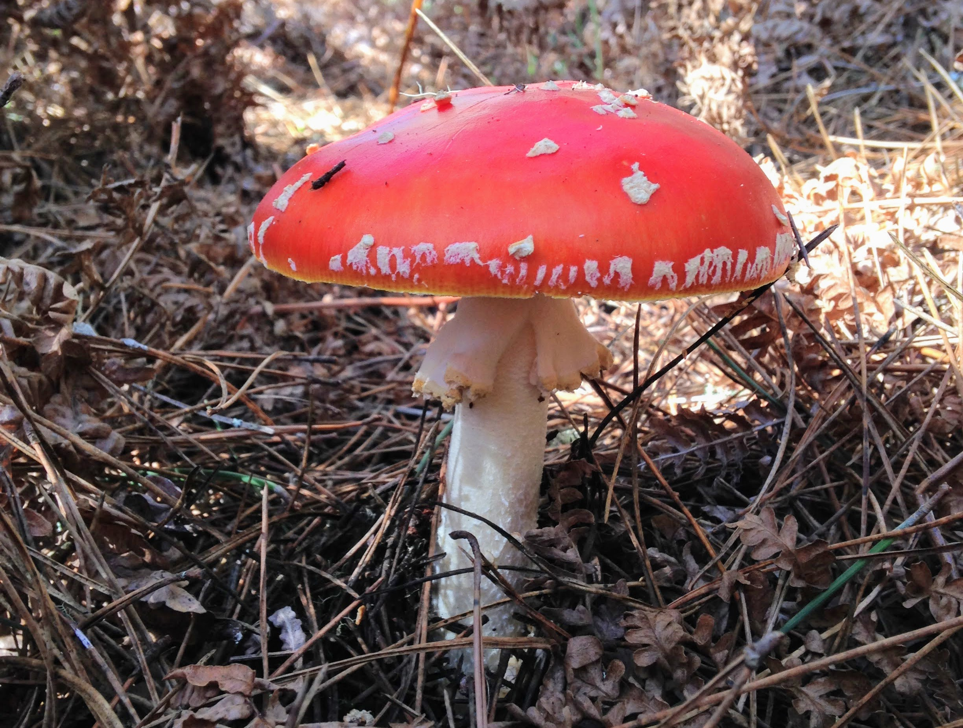
Plants can host dozens of fungi at once
And the fungi are diverse:
Ectomycorrhizal lifestyle has evolved many times
Notes:
Plants probably evolved this habit themselves about 30 times.

Slide 10
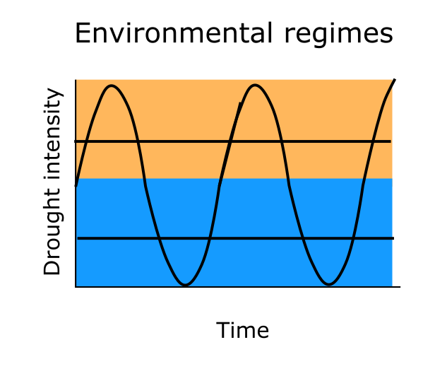
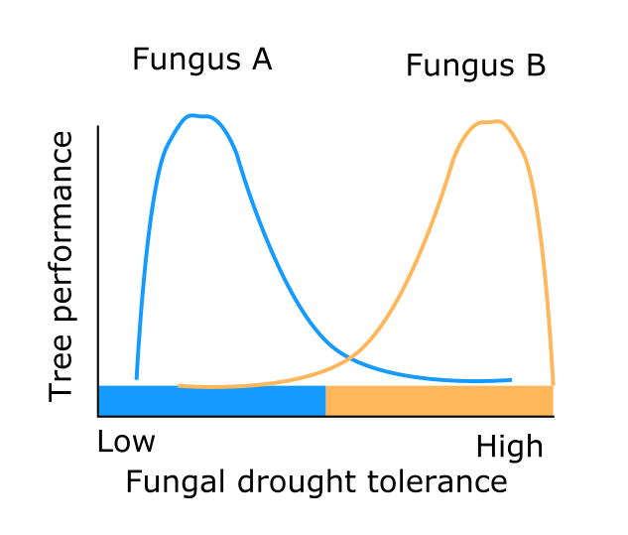
Mycorrhizal fungi: A buffer against stress?
How variable are fungal benefits?
Can plants choose their fungi depending on benefit?

Slide 11



The symbiotic spectrum
dry season
Fungus
hurts
Fungus helps
wet season
Context is key

Slide 12
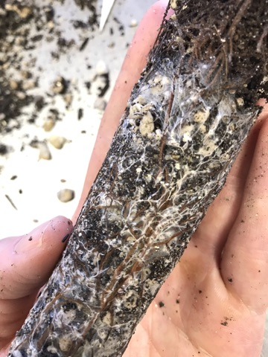
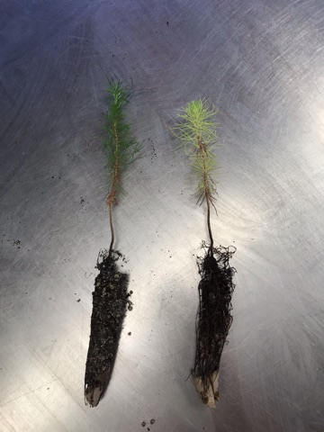
What is a “benefit” to a seedling?
Biomass gains?
Nutrition or water status?
Retaining function during stress?
Survival?

Slide 13
Using microscale tools to understand macroscale outcomes in plant symbiosis
Can plants reward helpful fungi?
Resource trading with isotope labeling
Molecules
Individuals
Communities
Notes:
So really, to understand these macroscale patterns, we need to zoom into the processeses happening at a molecular scale, between individual plants and fungi. Today I’ll take you on two deep dives:

Slide 14
Using microscale tools to understand macroscale outcomes in plant symbiosis
How does water and N stress affect symbiosis?
Physiology and gene expression
Molecules
Individuals
Communities
Notes:
So really, to understand these macroscale patterns, we need to zoom into the processeses happening at a molecular scale, between individual plants and fungi. Today I’ll take you on two deep dives:

Slide 15
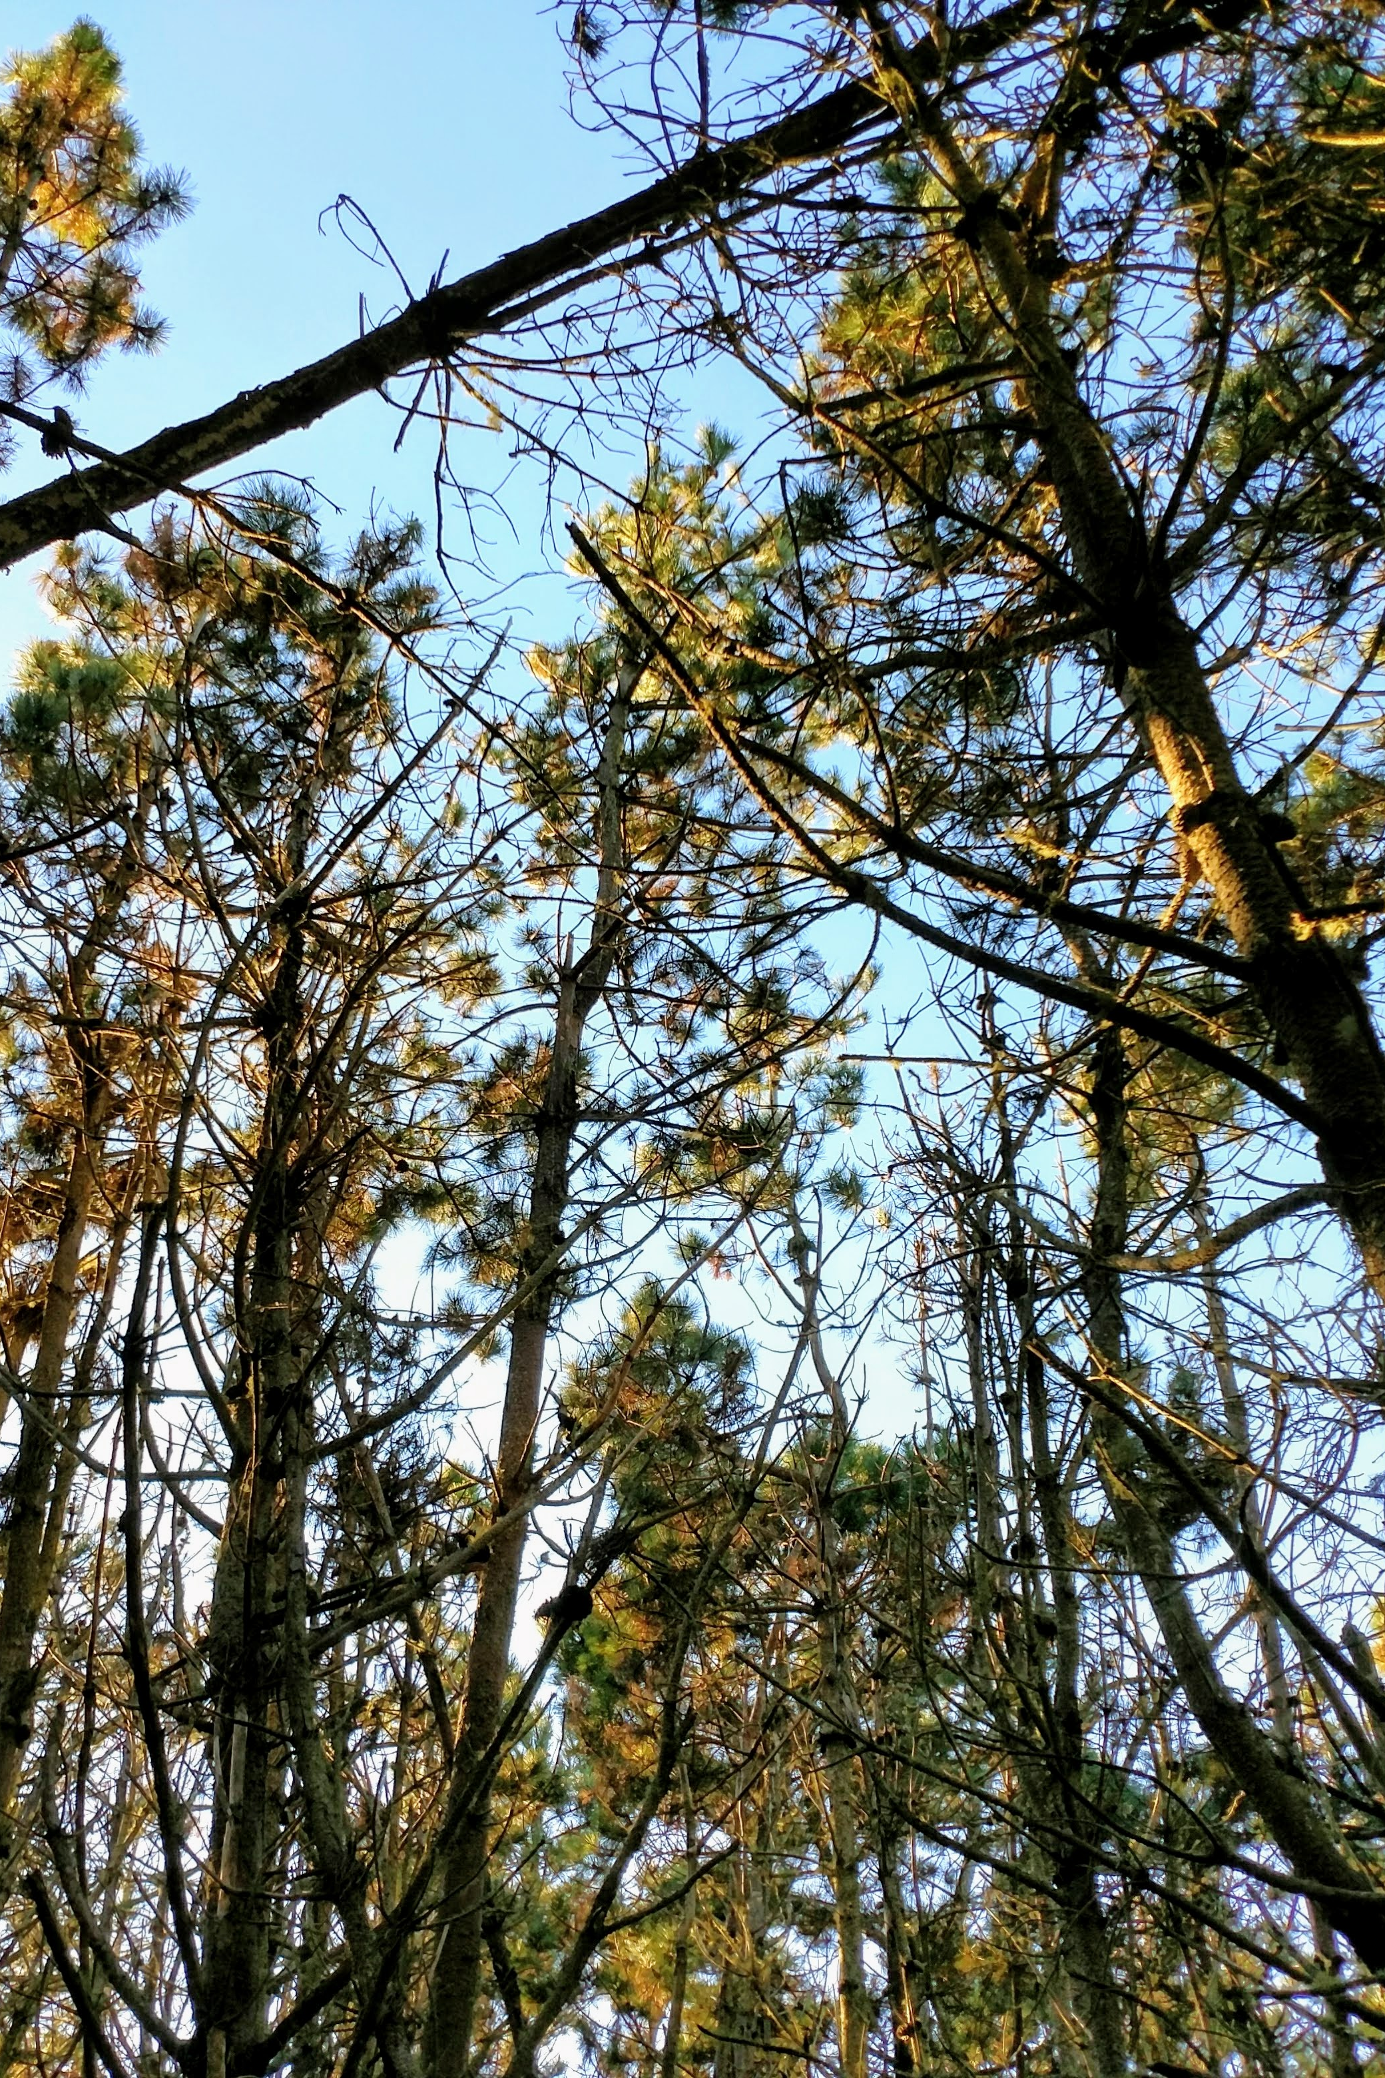
Can plants reward helpful fungi?
Investigating the rules of resource trading in ectomycorrhizal symbiosis

Slide 16
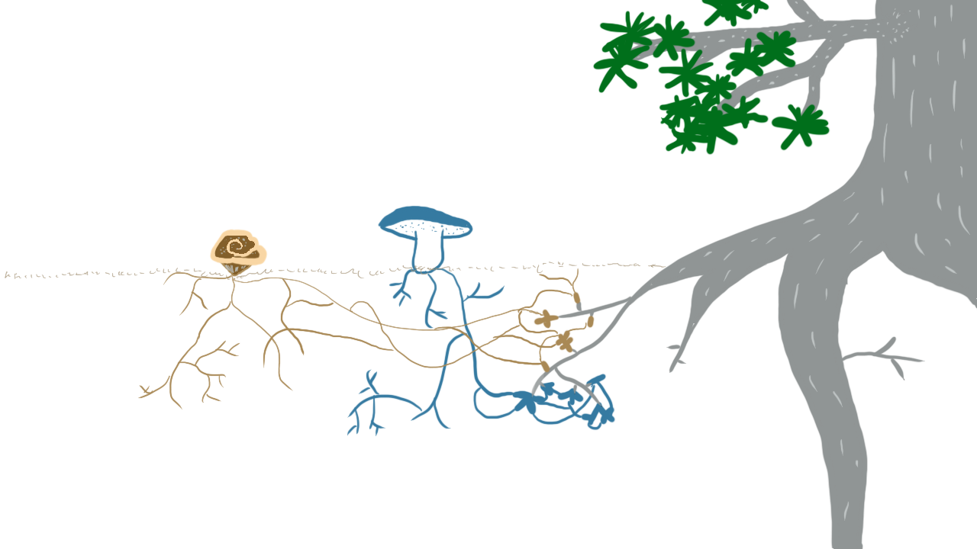
What would rewards look like?

Slide 17
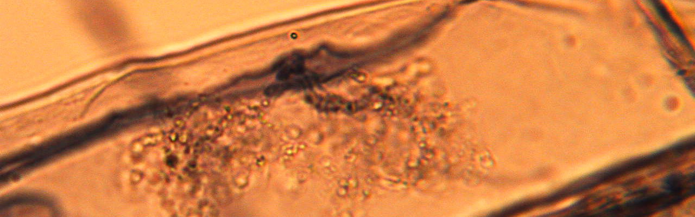
Plant rewards
Demonstrated in root symbiosis with Glomeromycotan fungi (not ectomycorrhizas) (Bever et al. 2009, Kiers et al. 2011, Argüello et al. 2016)
Would allow cultivation of “helpful” community (Simms & Taylor 2002, Werner et al. 2014)

Slide 18
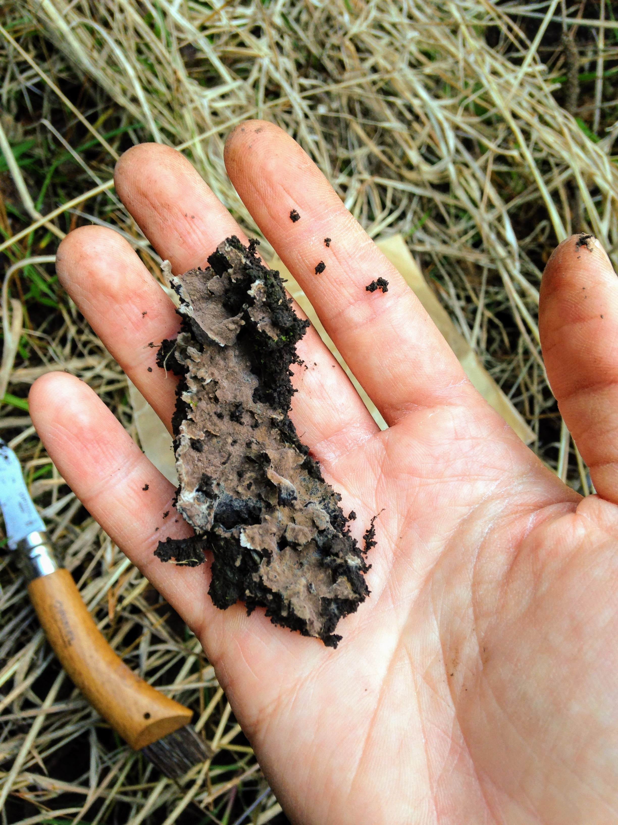
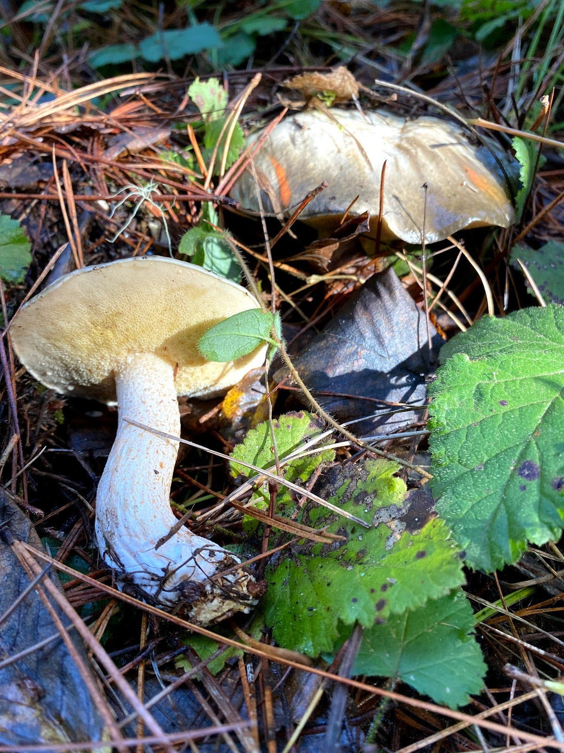
Suillus pungens
Focal fungi
Thelephora terrestris
Common in California pine forests
Often grow on seedlings
← Pine specialist
Broad host generalist →
Common greenhouse contaminant →

Slide 19
Major questions
Can the plant reward fungi that provide N?
Does this depend on environmental context?
Does the plant reward the fungus that most improves growth?

Slide 20
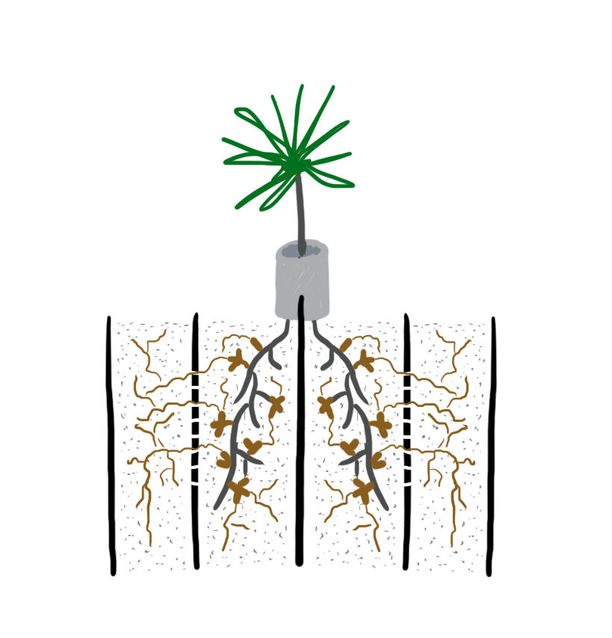
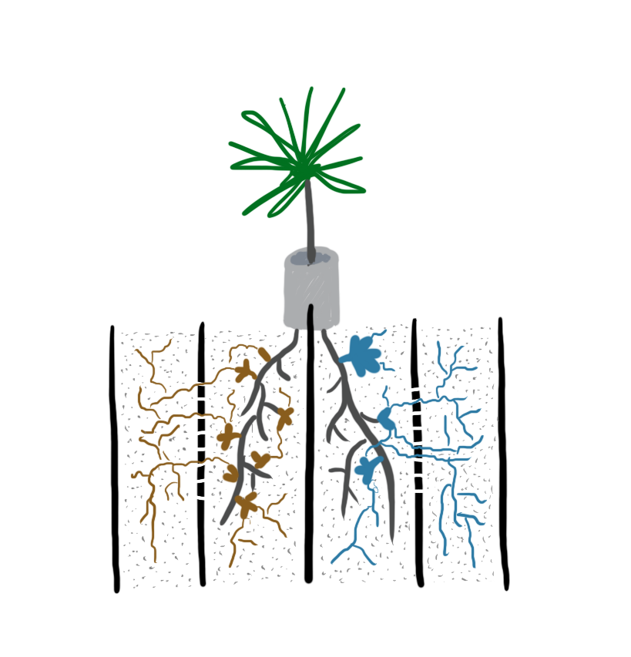
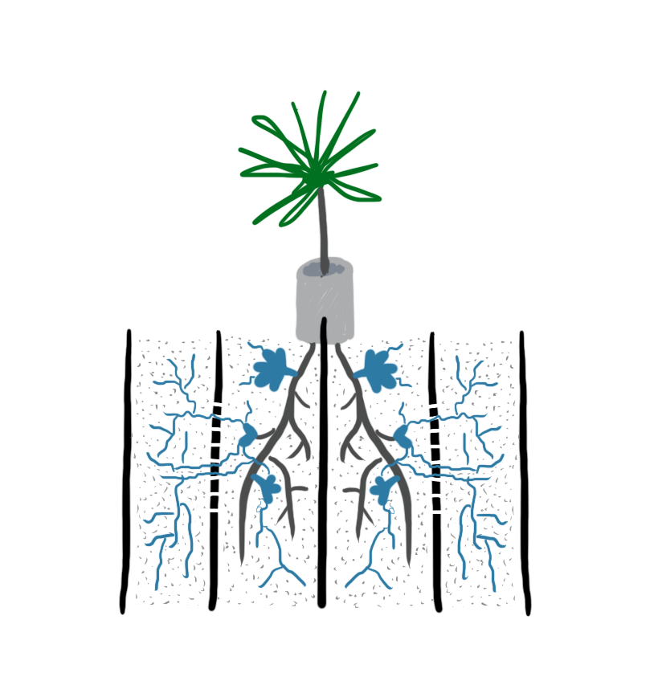
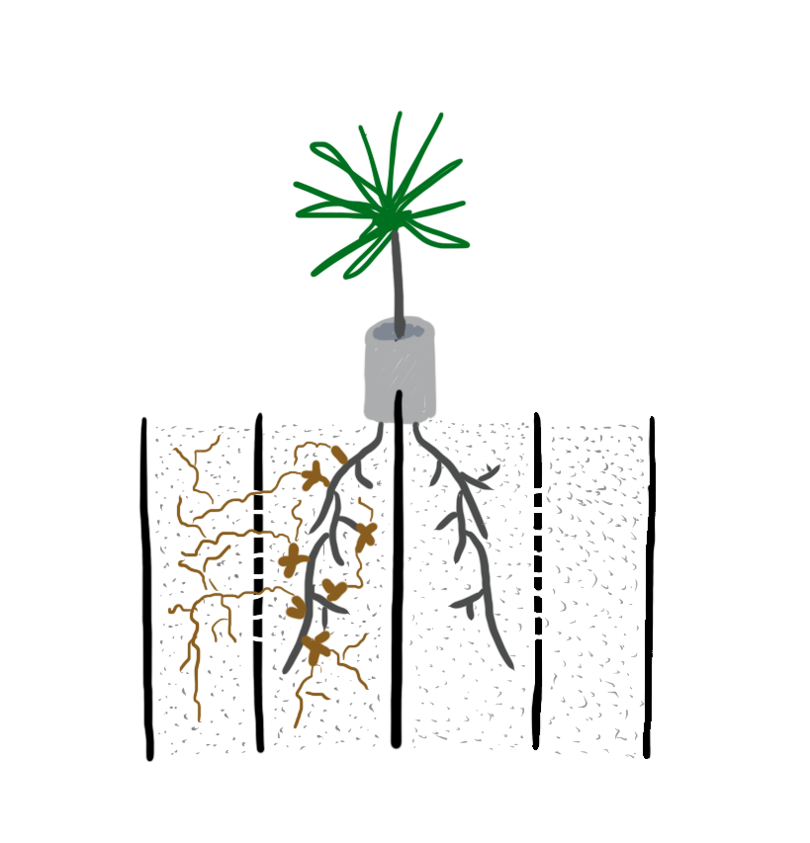
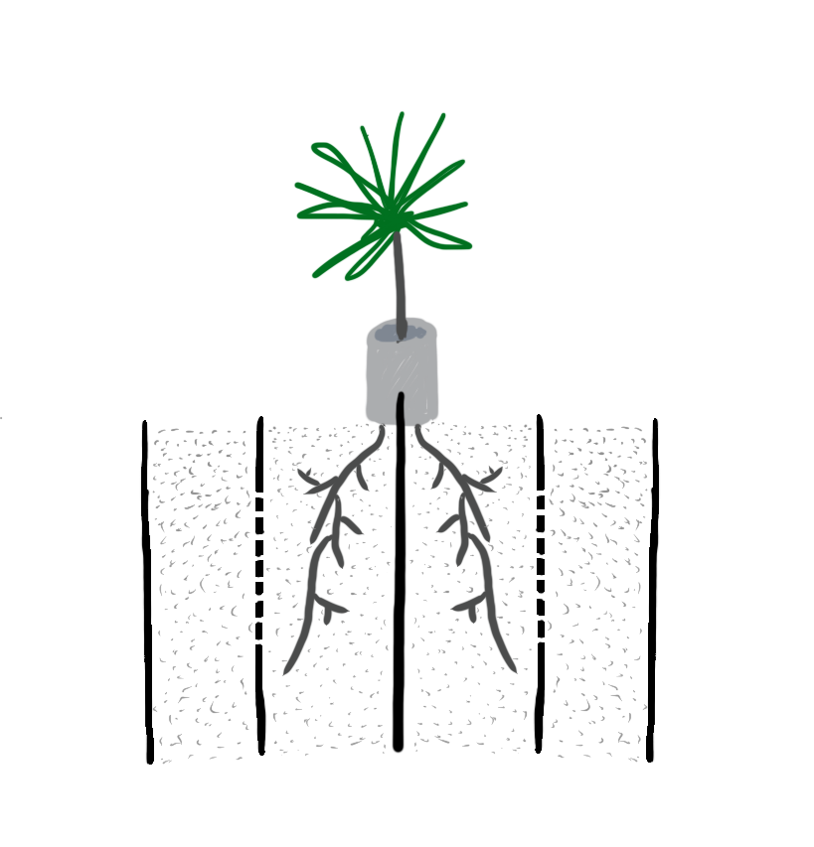
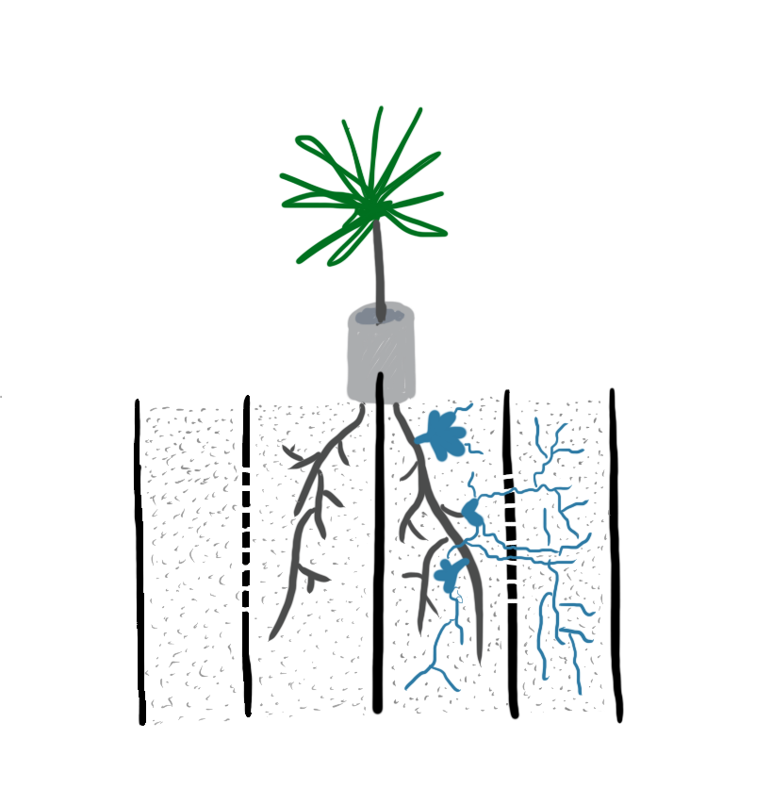
Experimental design
\
High N
X
Low N

Slide 21
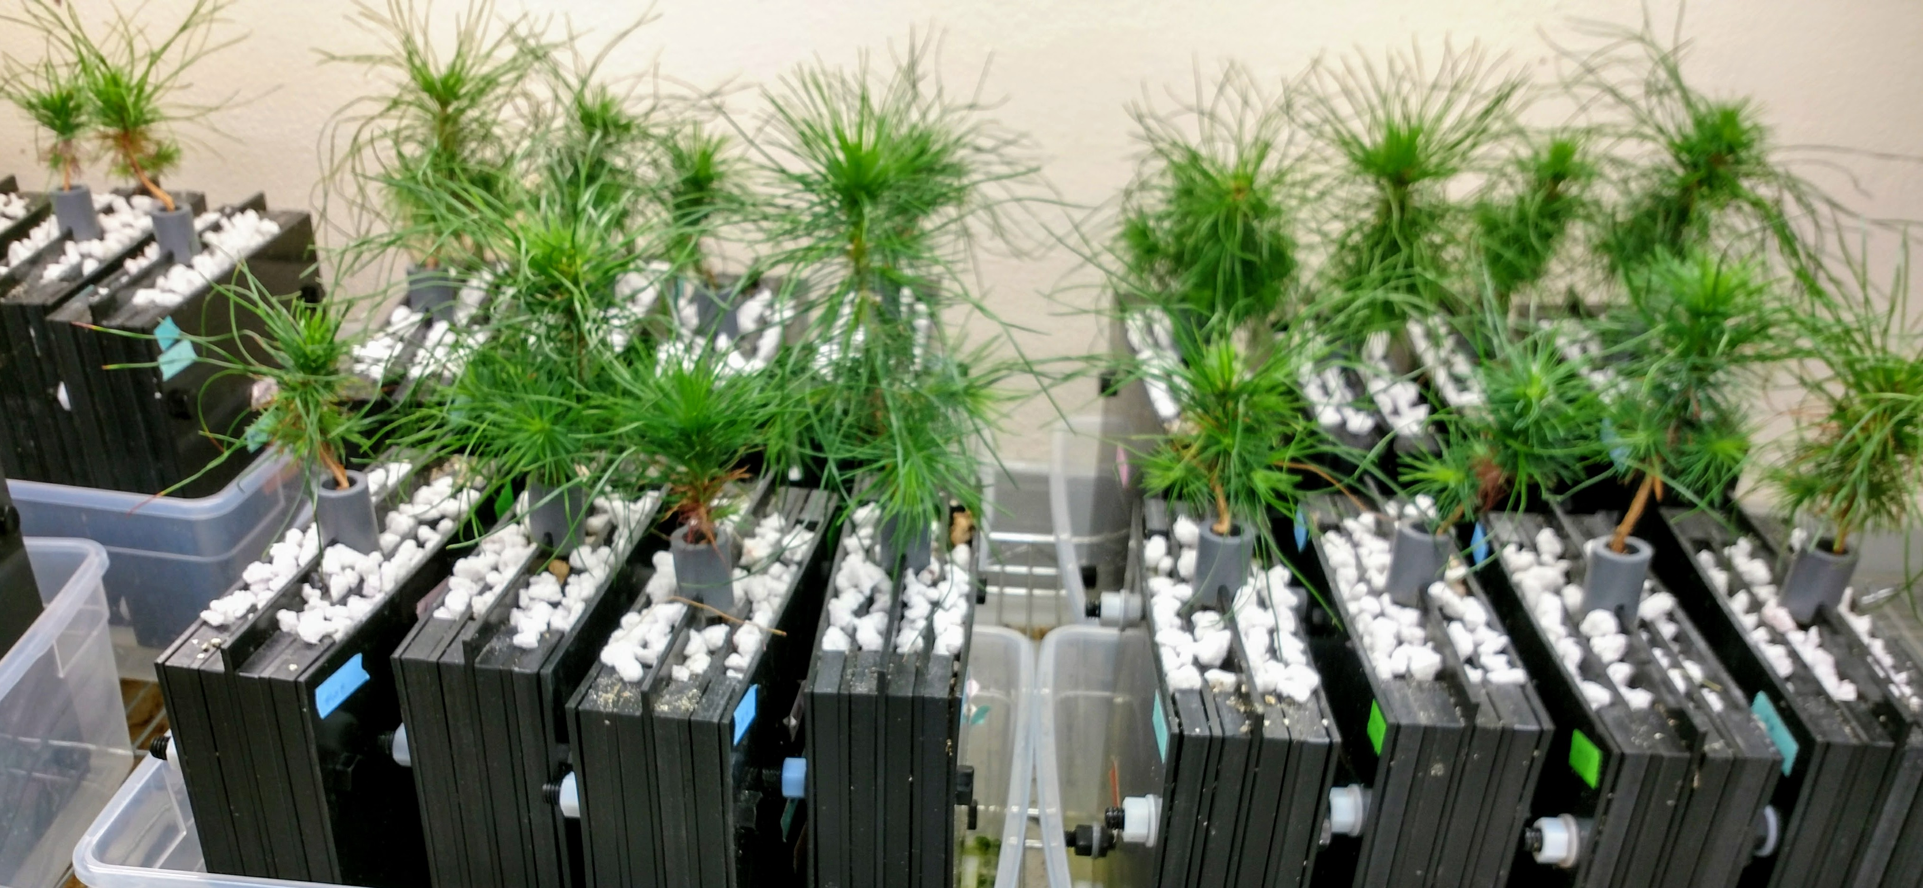
Split-root pots with fungus-only chambers

Slide 22


Drake Johnson
Fungus
Roots
Mesh barrier
Solid barrier

Slide 23

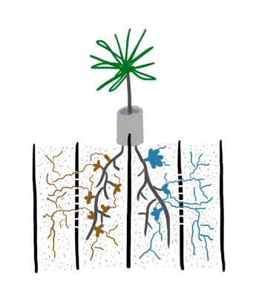


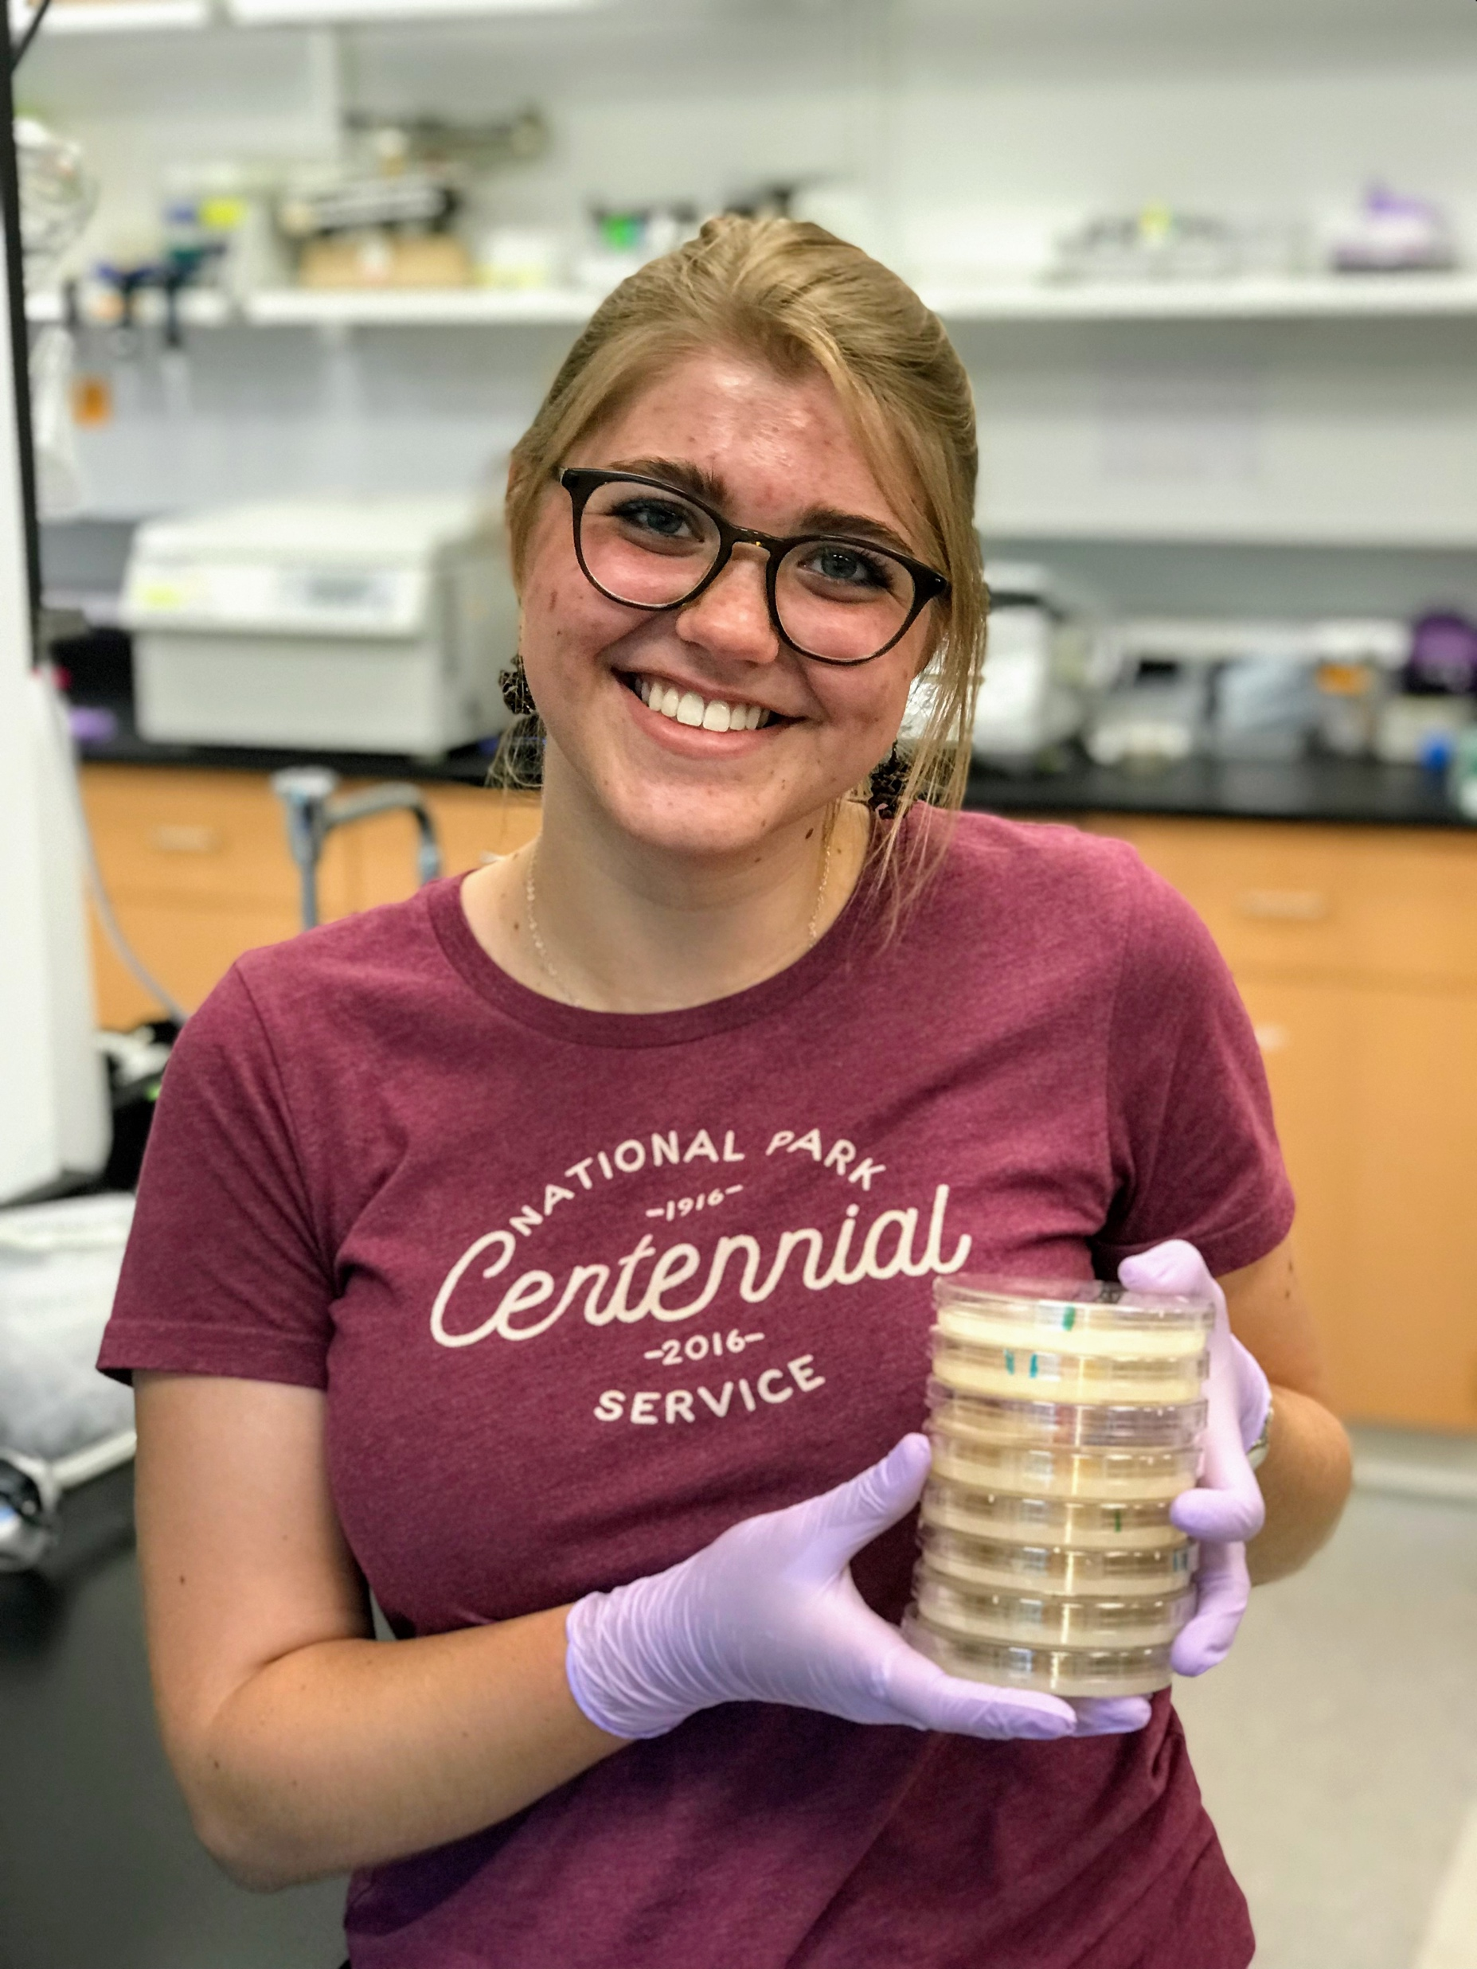
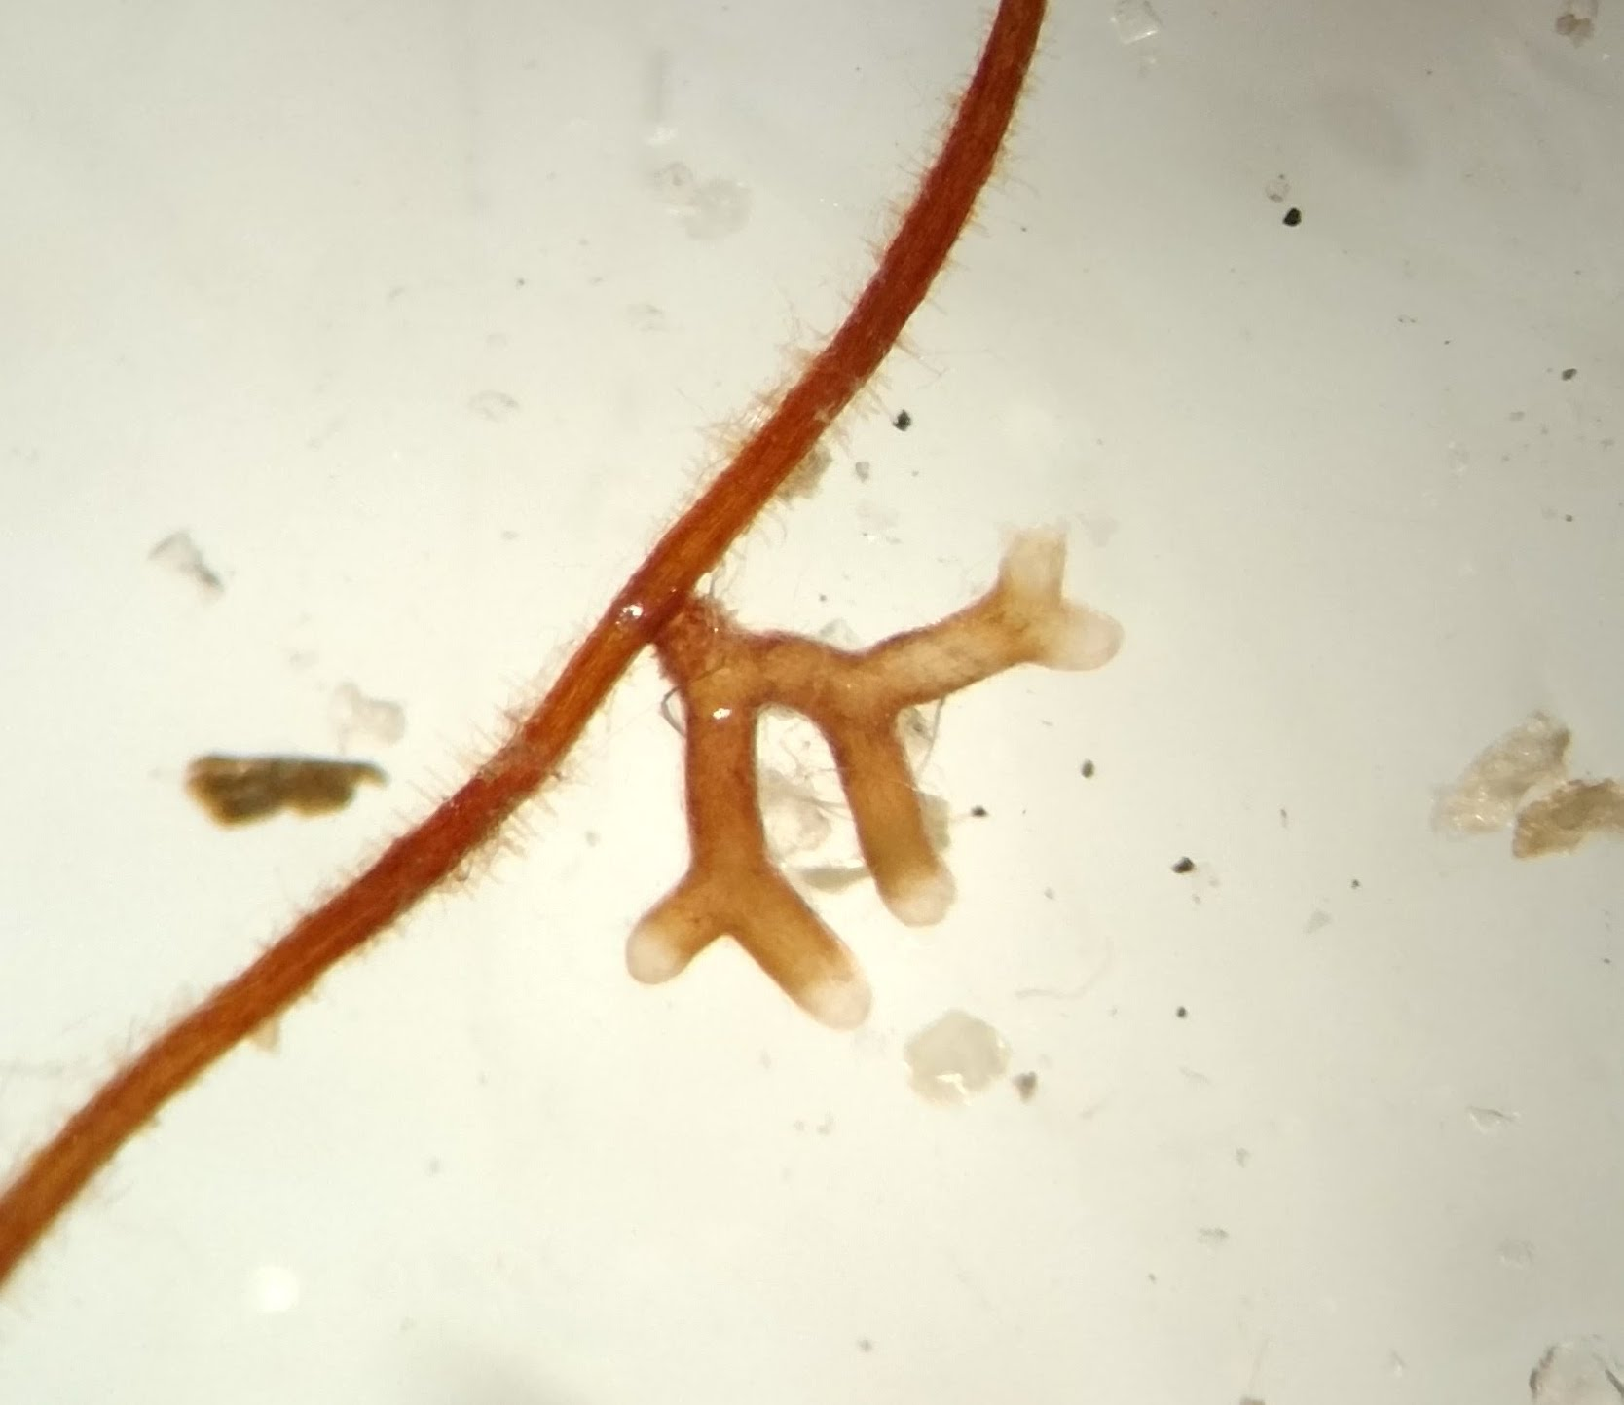
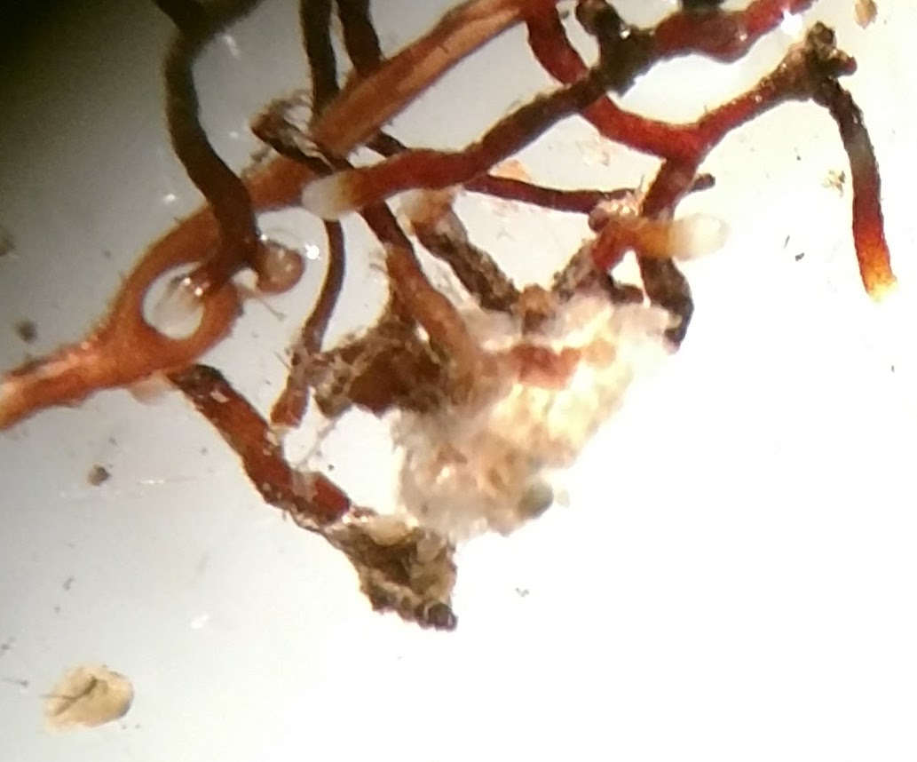



¹³C and ¹⁵N labeling
¹³CO₂
unenriched
NH₄⁺
¹⁵NH₄⁺
Arvie Violette
Caroline Blythe

Slide 24
Does the plant give more C to fungi providing N?
C for N rewards depend on fungal identity
High
Low
Yes, but only for Thelephora

Slide 25
Given a choice, which fungus got more C from the plant?
C allocation responds to factors beyond N provisioning
More C to Tt
More C to competitor
Thelephora (marginally) in high N; Suillus in low N.

Slide 26
... and is the plant’s “preferred” fungus more helpful to growth? (Tt high, Sp low)
C allocation may not reflect long-term growth benefits.
Fungal treatment
Yes, in high N. In low N, nothing grew well.

Slide 27
Conclusions
Does plant C correspond to fungal N?
It can, but need not.
Does the plant reward the fungus that most improves growth?
Not necessarily.
Plants may control fungi with C, but incompletely.

Slide 28
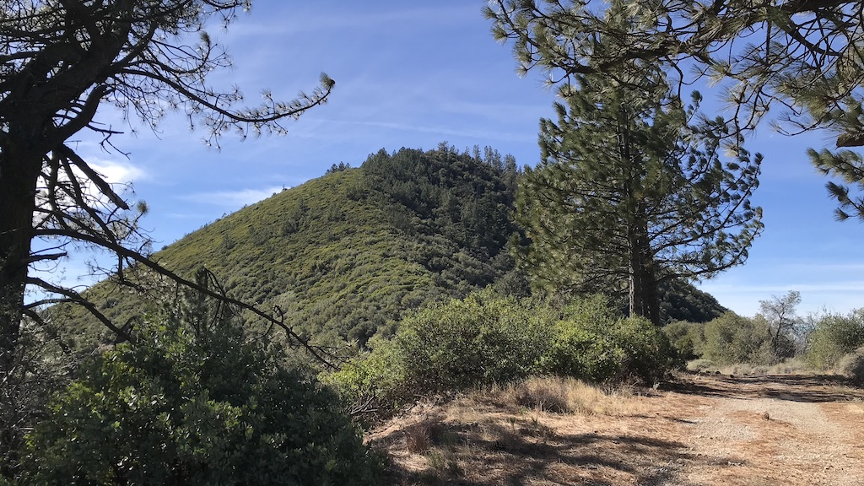
How does water and N stress affect symbiosis?

Slide 29
What we know
Fungi differ in dry vs wet sites
Fungi can shift plant response to water limitation
Fungi increase effective root system area

Slide 30
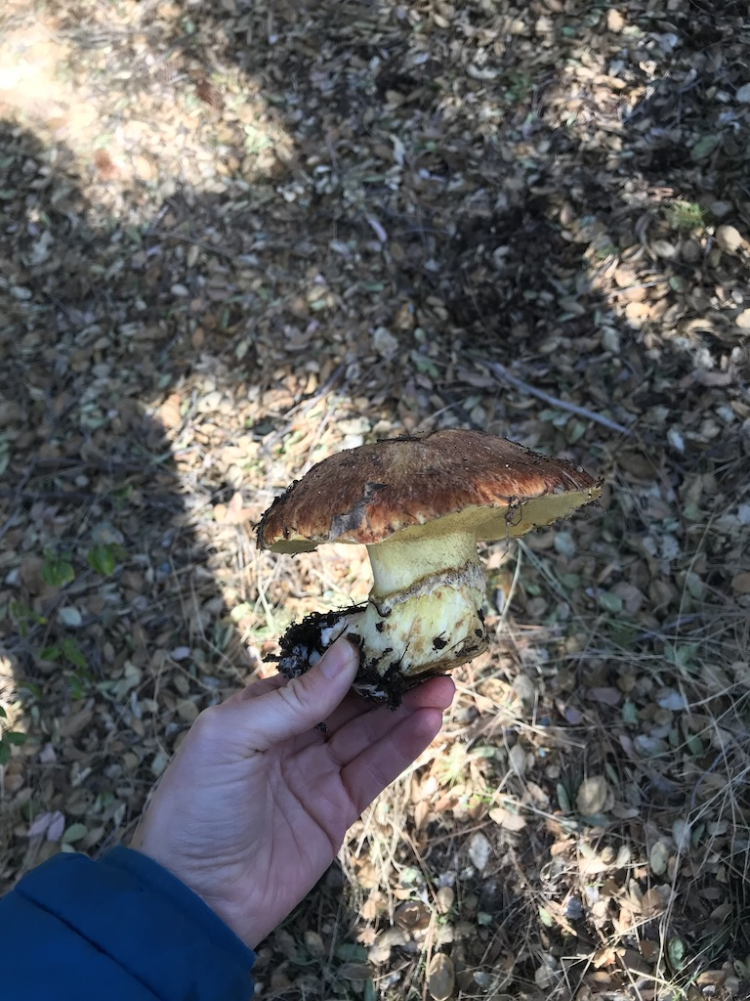
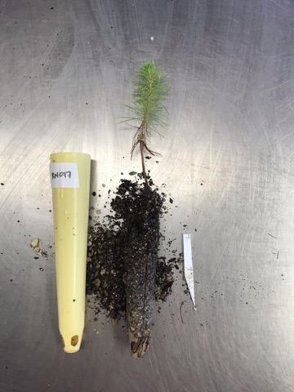
One plant, one fungus
Pseudotsuga menziesii
Today: Suillus lakei

Slide 31



How do water and N stress shift symbiosis?
Notes:
Staggered harvest across drydown. Measure:
shoot water potential (synthetic predawns)
Seedling biomass
Percent colonization
Targeted transcriptome sequencing
Understand how plant and fungl gene expression change

Slide 32
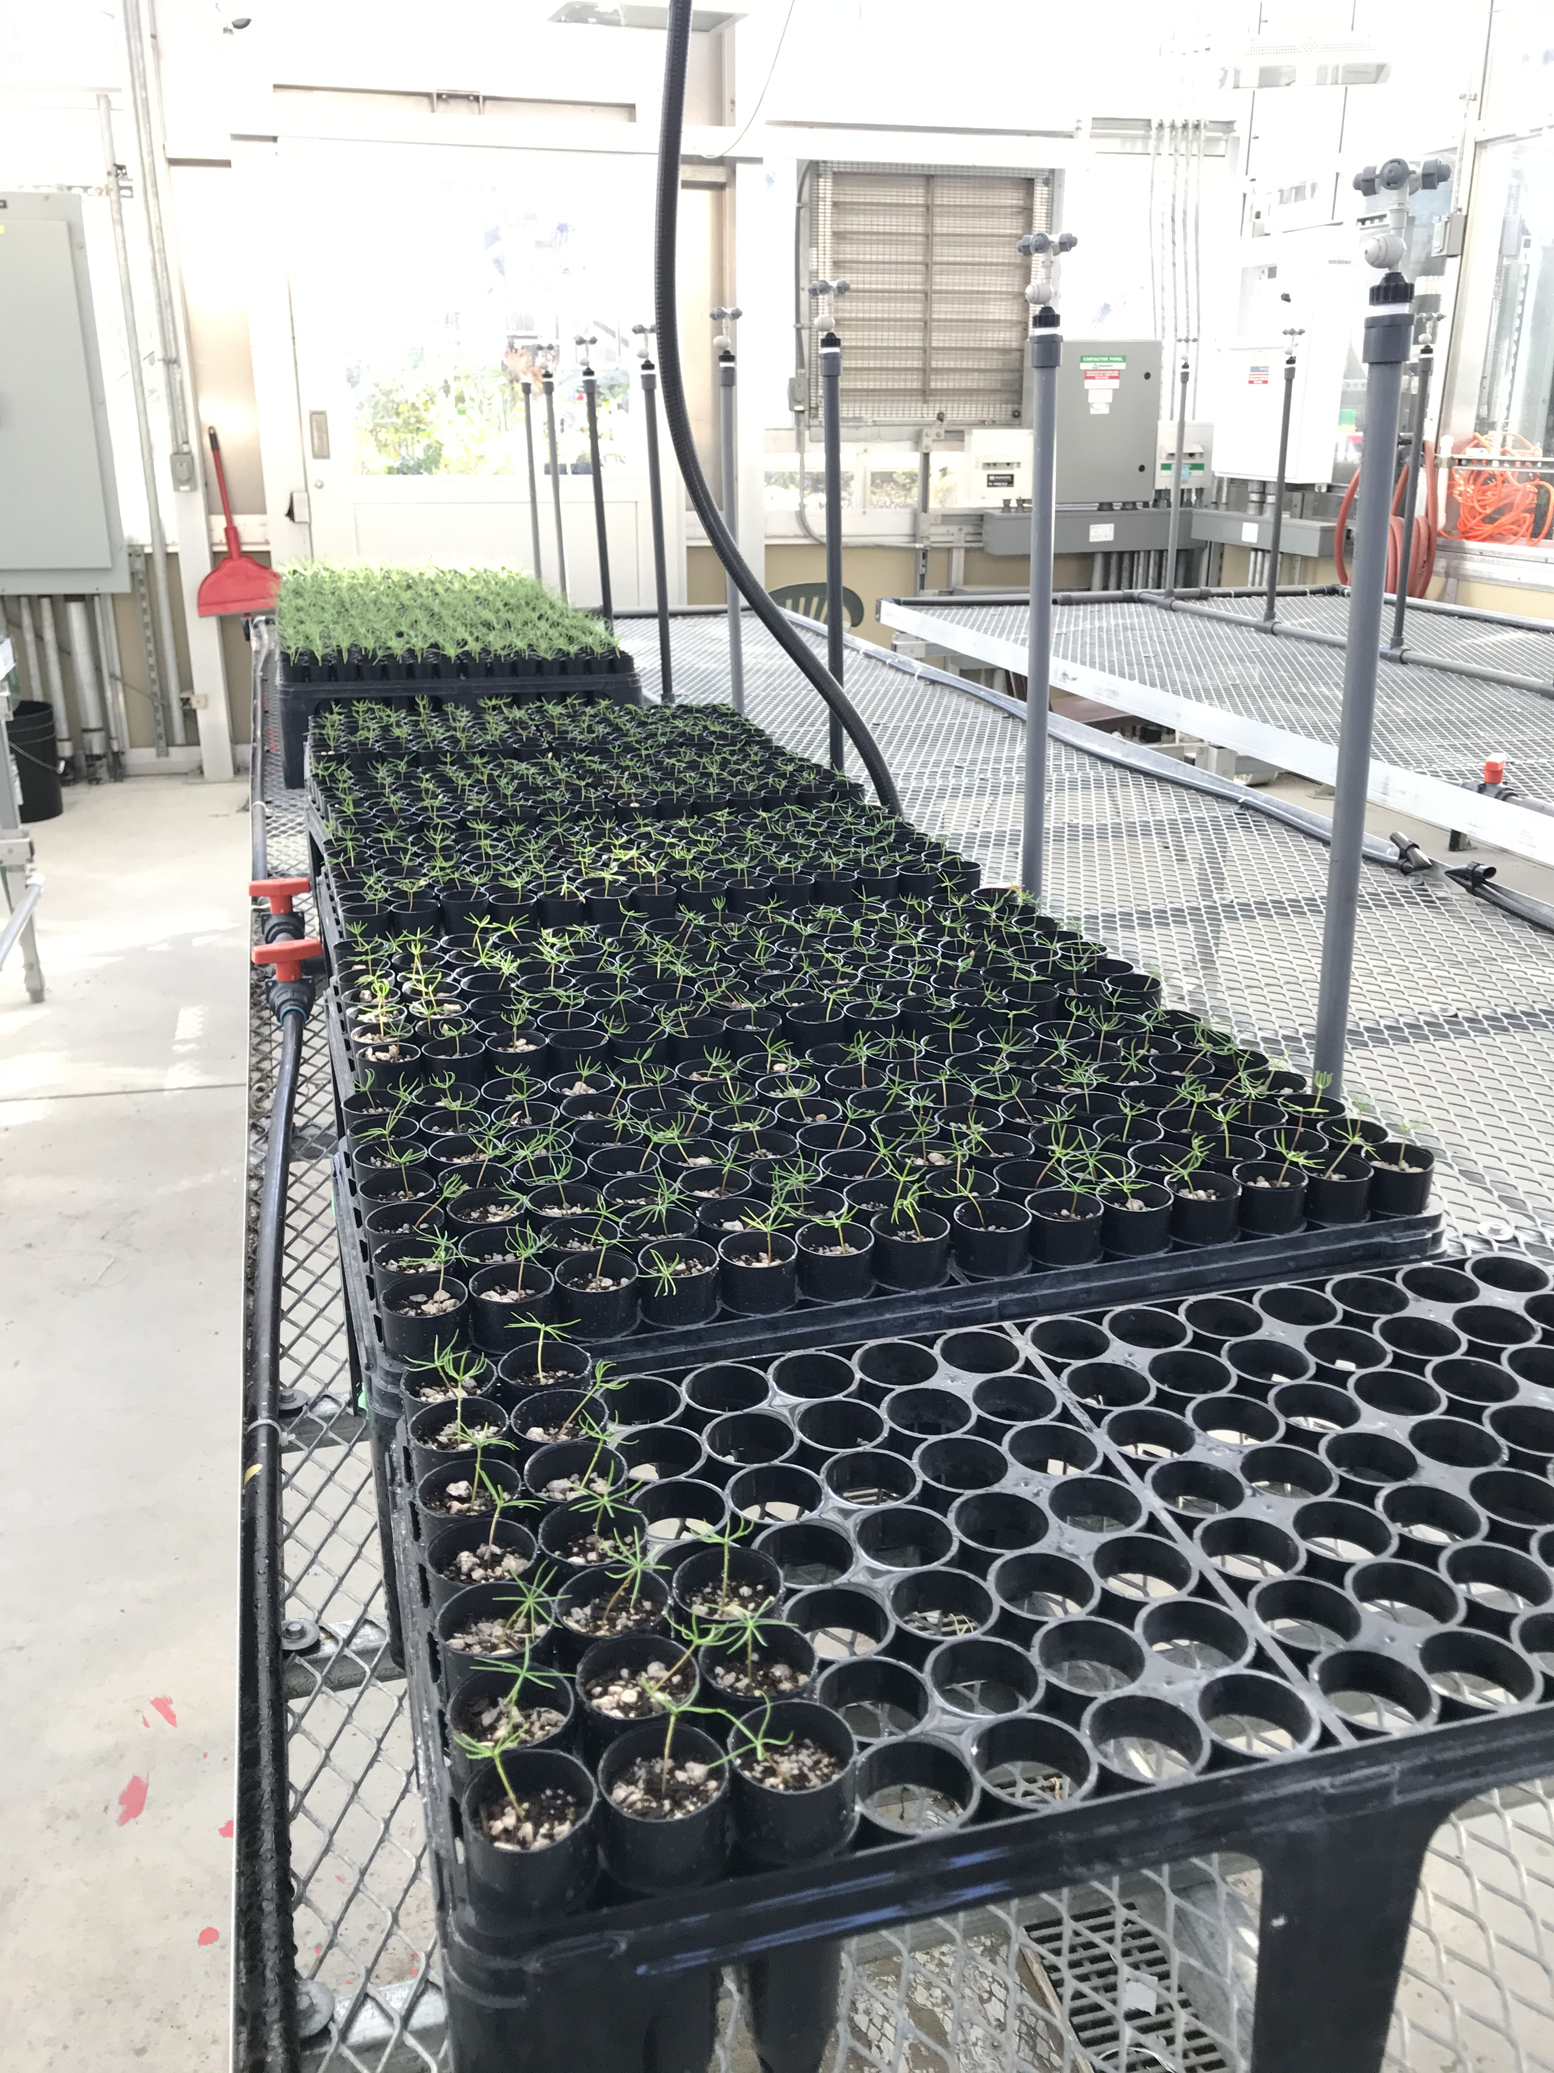
Preliminary findings

Slide 33
Seedlings buffer themselves against changing soil moisture

Slide 34
How do symbiotic mechanisms change with water stress?

Slide 35

How do water and N stress shift symbiosis?
Water limitation was stressful
N effects are subtle
Drydown didn’t change shoot water potential.
Gene expression data coming soon

Slide 36
Using microscale tools to understand macroscale outcomes in plant symbiosis
Fungal effects strongly context-dependent
Plants have imperfect control over fungi
Complex interplay of environment, physiology
C and N aren’t everything
Molecules
Individuals
Communities
Notes:
To study cryptic organisms like fungi, we often need molecular tools to get at larger-scale questions. This allows us to bridge several levels of organization at once!

Slide 37
Goals
Introduce ectomycorrhizas as key player in tree/environment interactions.
Spark conversations about methods, experiments, approaches that could help connect symbiosis and tree drought physiology.

Slide 38
Using microscale tools to understand macroscale outcomes in plant symbiosis
Molecules
Individuals
Communities
Contact me at UC Davis starting July 2022! lmbogar@ucdavis.edu
Notes:
To study cryptic organisms like fungi, we often need molecular tools to get at larger-scale questions. This allows us to bridge several levels of organization at once!

Slide 39
Extra slides and plots

Slide 40
Does the environment shift symbiotic function?

Slide 41
Delayed water potential measurements are artificially low

Slide 42
Do fungi shift the plant’s relationship with soil water?

Slide 43
Using microscale tools to understand macroscale outcomes in plant symbiosis
Molecules
Individuals
Communities
Notes:
So really, to understand these macroscale patterns, we need to zoom into the processeses happening at a molecular scale, between individual plants and fungi. Today I’ll take you on two deep dives:

Slide 44
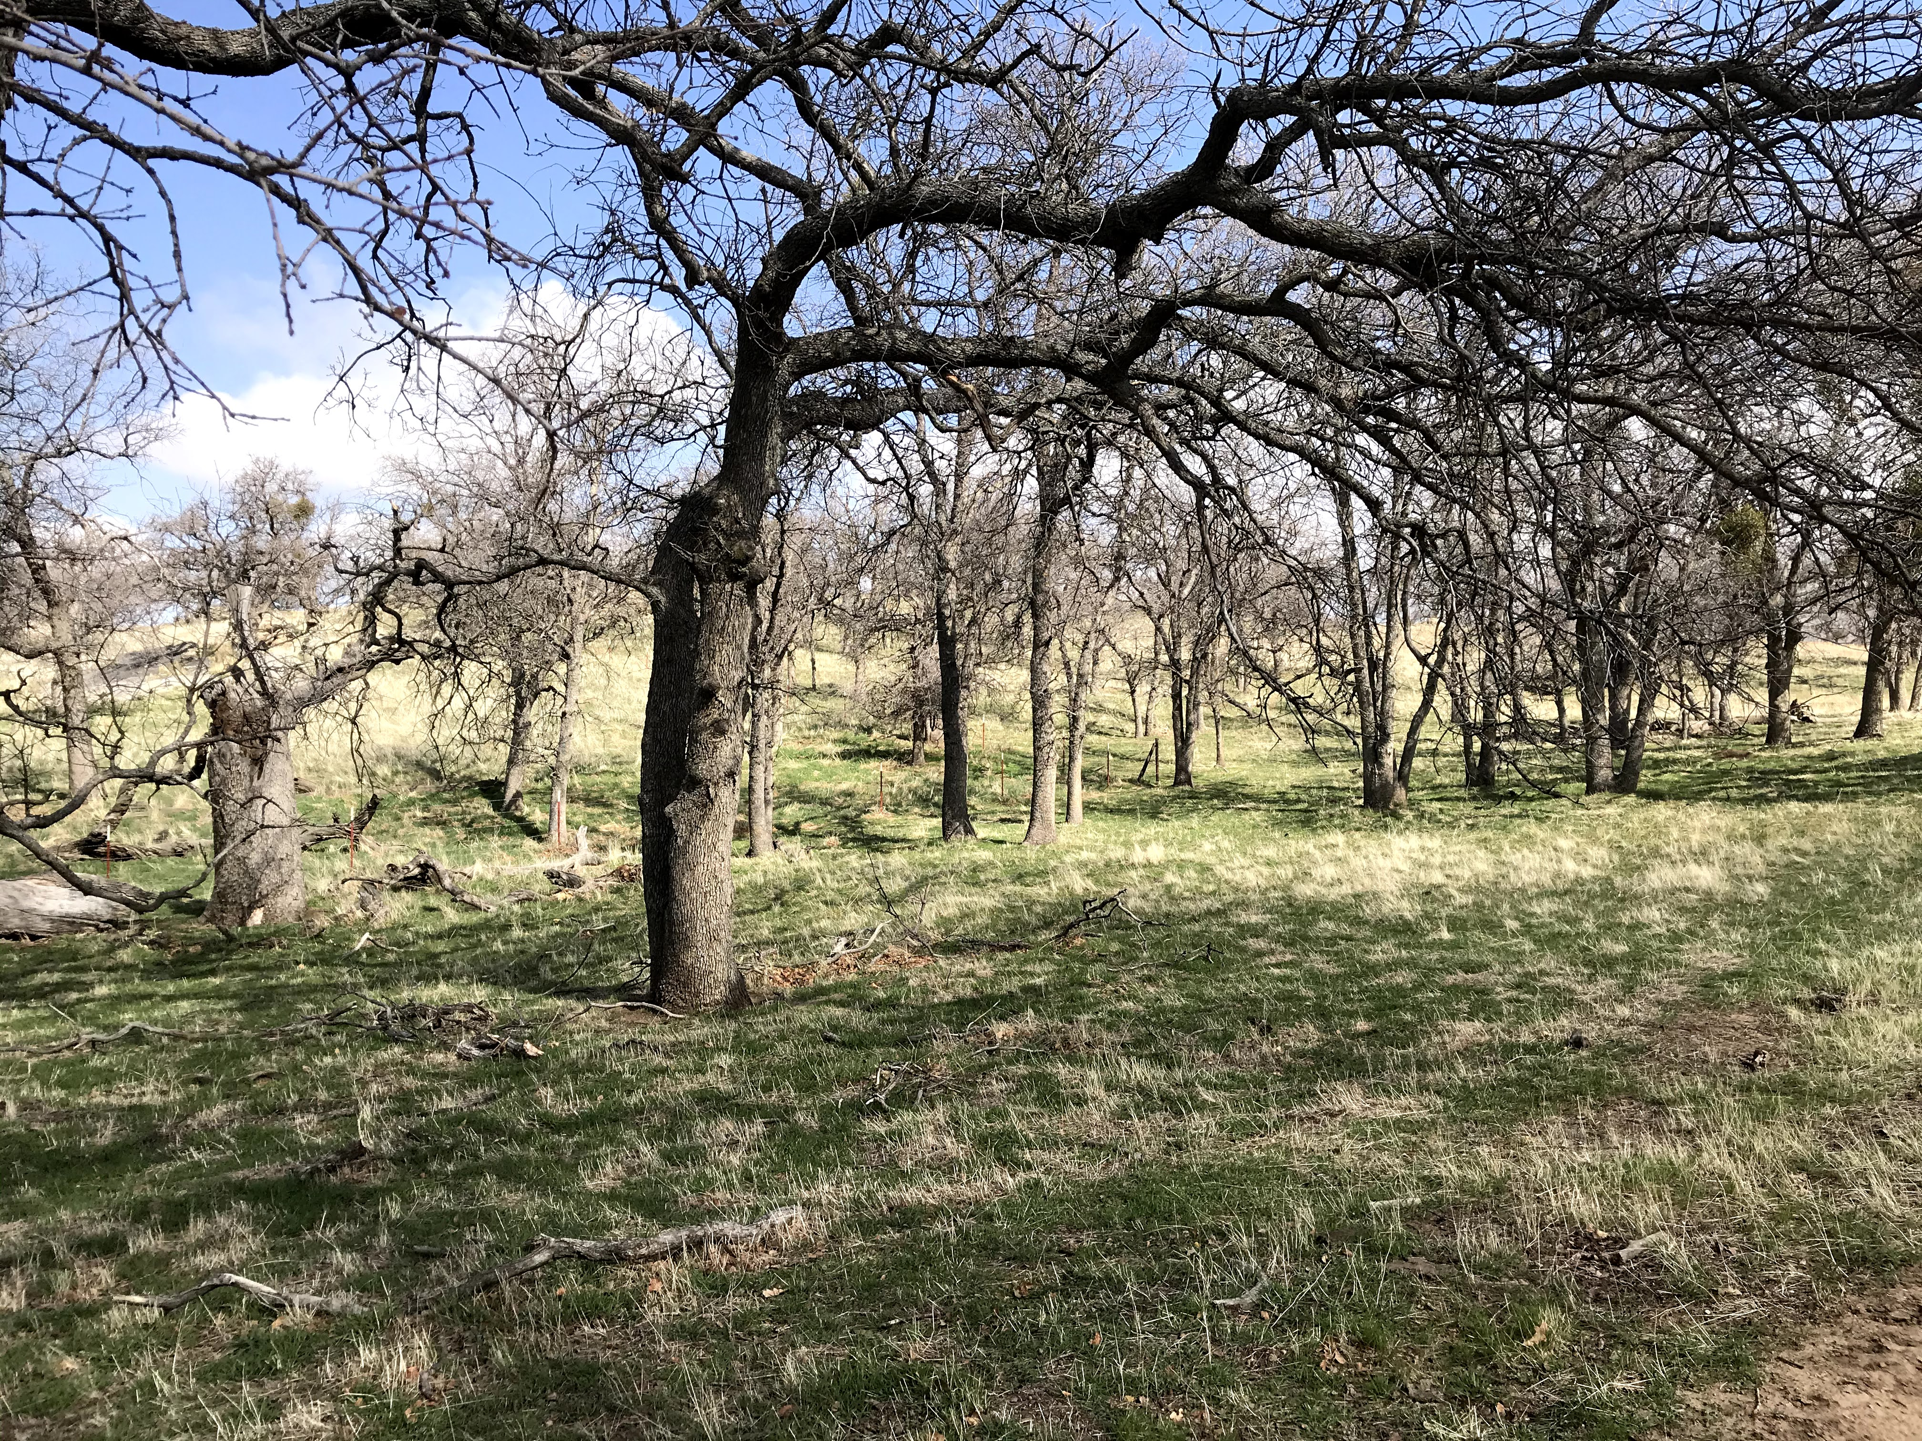
Oaks on a warming coast
Can fungal communities improve seedling drought response?
(Ronja Keeley undergraduate thesis)

Slide 45

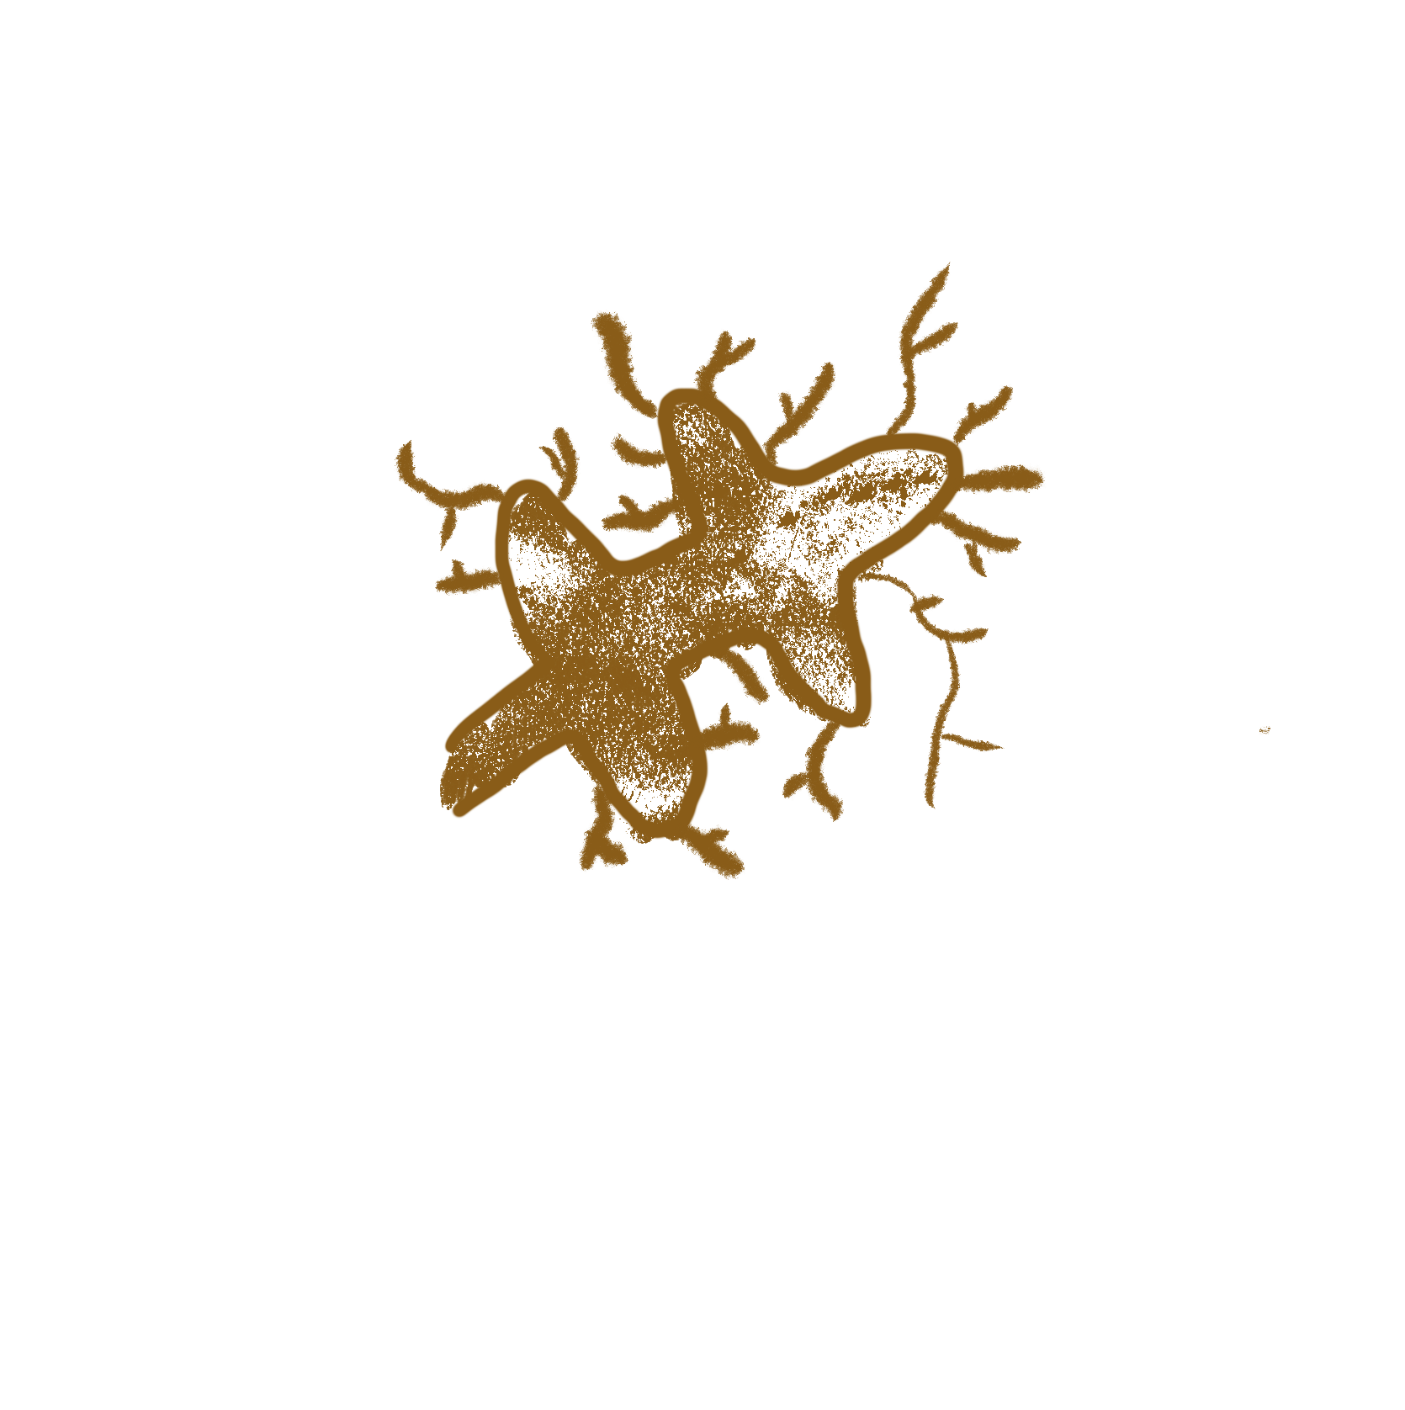
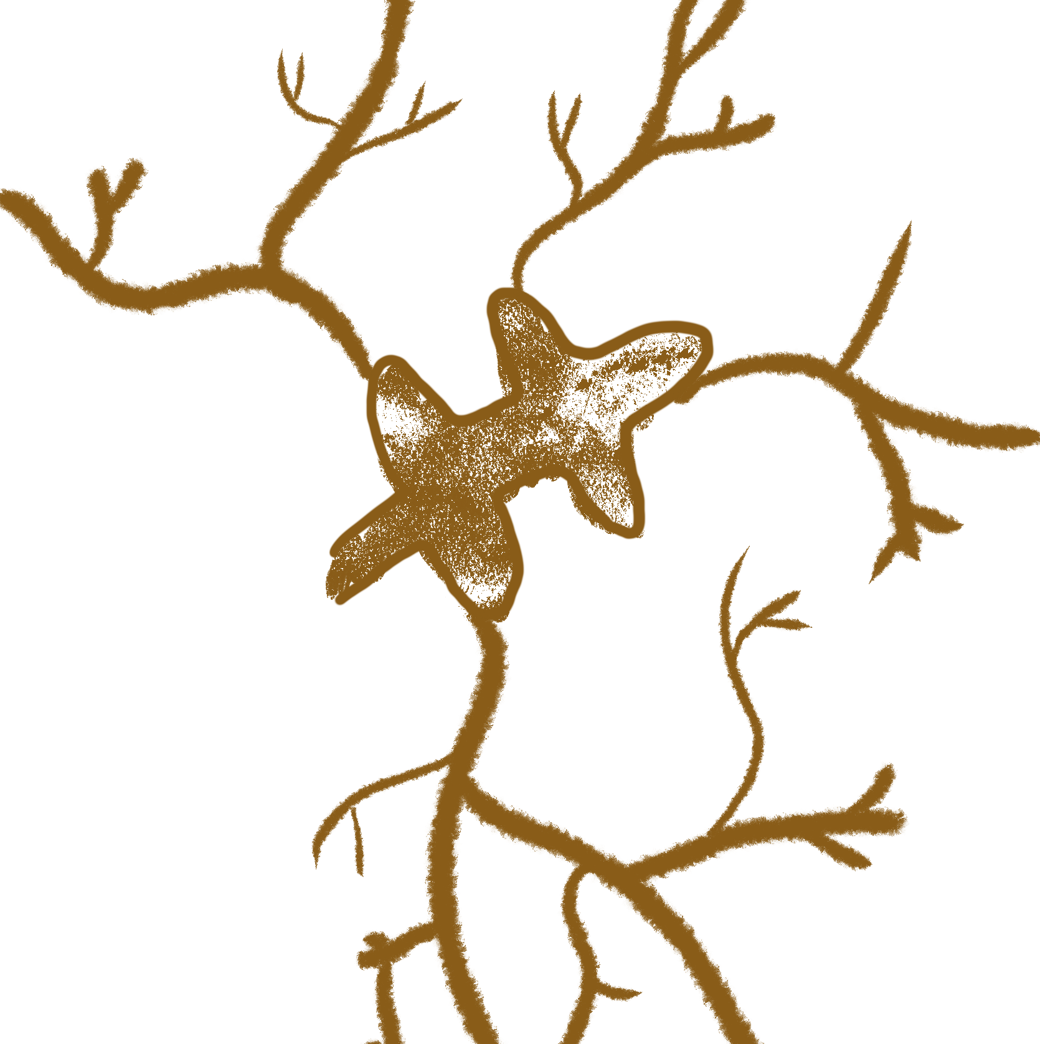
Arid and mesic oak fungi have different functional traits
Fungal biomass
Fungi sampled from arid sites had more (putatively) drought tolerant traits (Bui et al. 2020 FEMS Microb Ecol)
Water availability

Slide 46
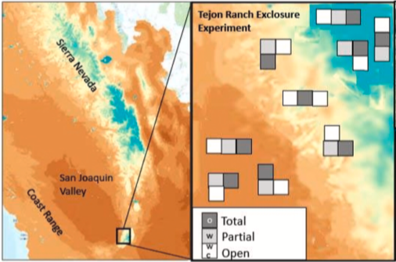
Can fungal communities improve seedling drought response?
Collected soils from 3 arid and 3 mesic sites
Inoculated 350 Quercus lobata seedlings
Parsons et al. 2021 Forest Ecol Mgmt

Slide 47
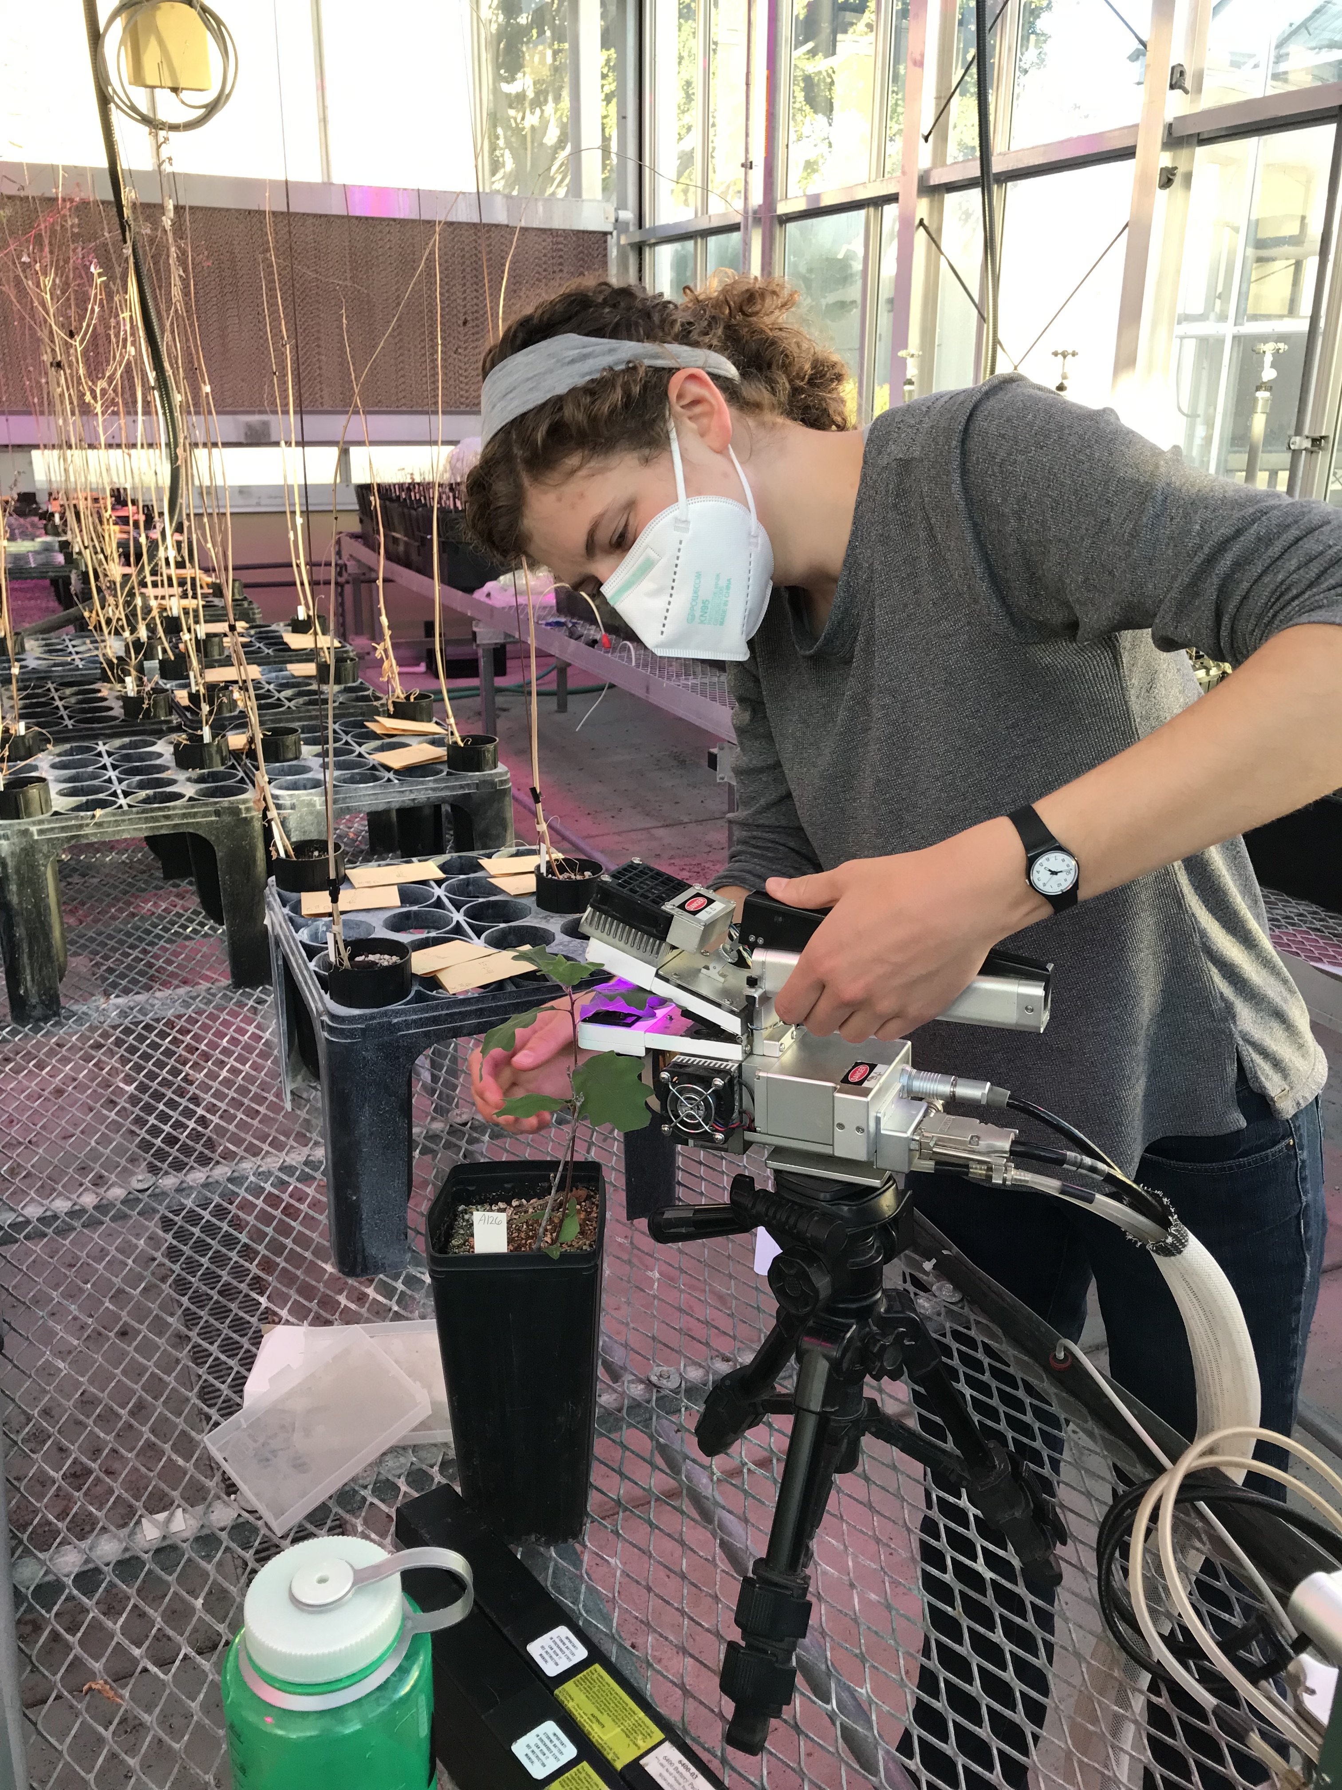
Can fungal communities improve seedling drought response?
Drought treatment since early March
Measuring growth, photosynthetic performance; sequence fungi at end
Ronja Keeley

Slide 48
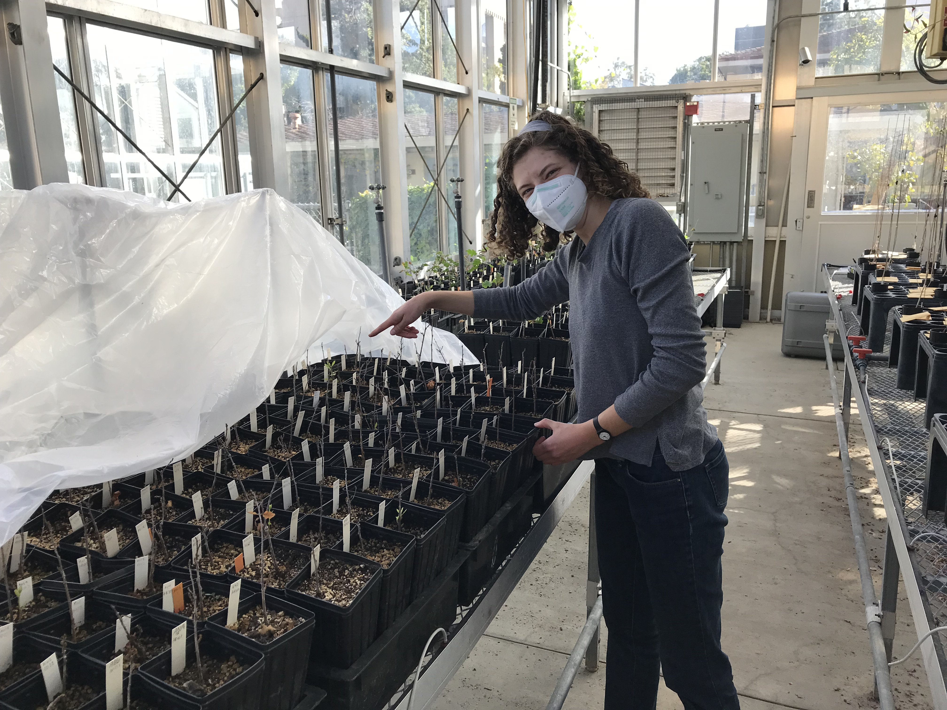
Will fungi improve drought coping?
Seedlings in soils from arid sites will withstand drought better
Their fungi will have more drought-tolerant traits

Slide 49
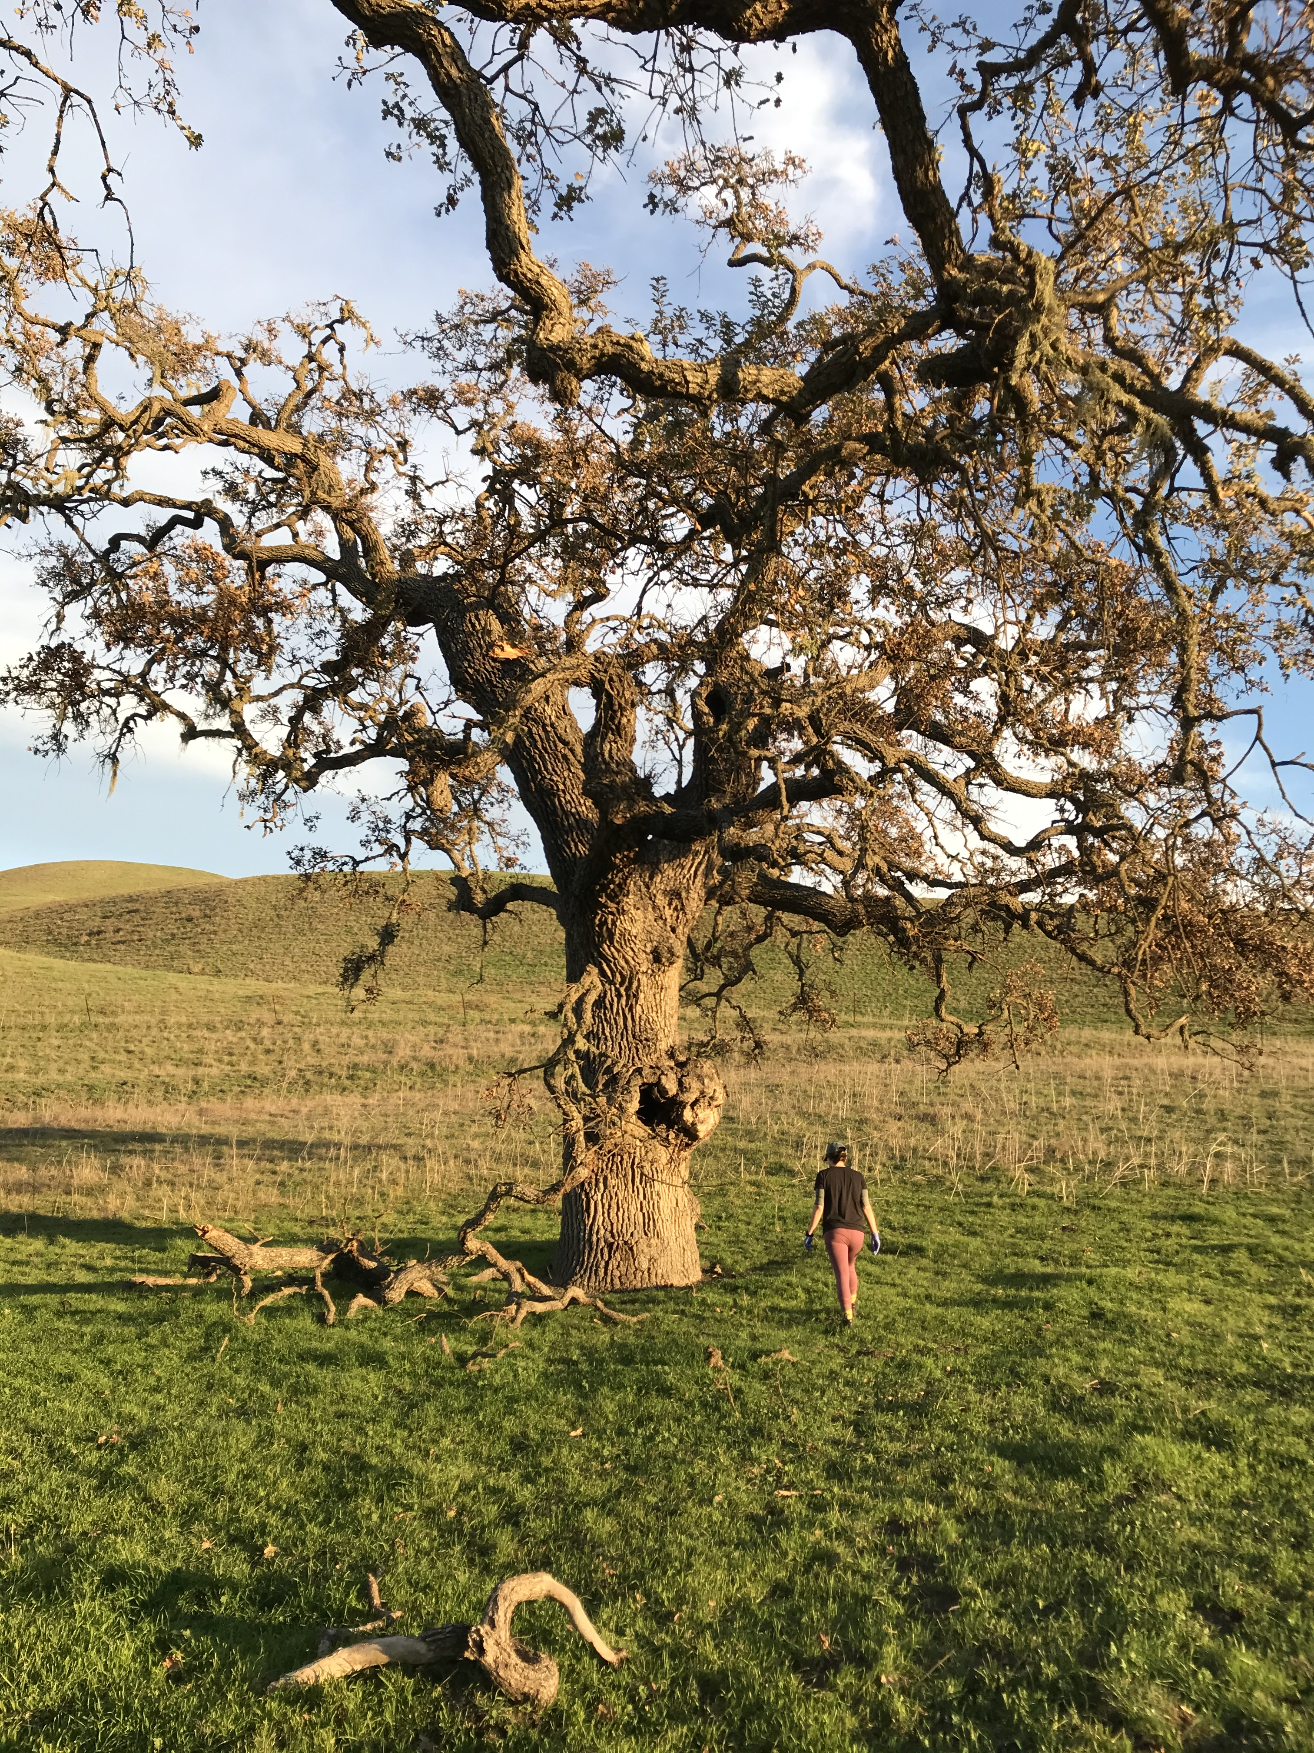
If fungi affect seedling drought tolerance...
Incorporate into assisted migration, planting
Follow-up: What makes some symbiotic economies work better for the plant than others? (gene expression, resource movement, etc.)

Slide 50
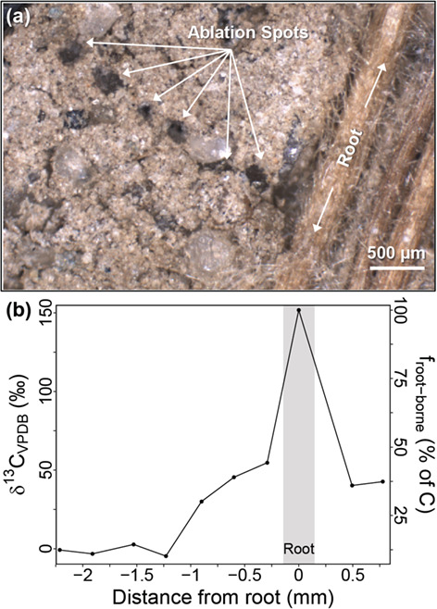
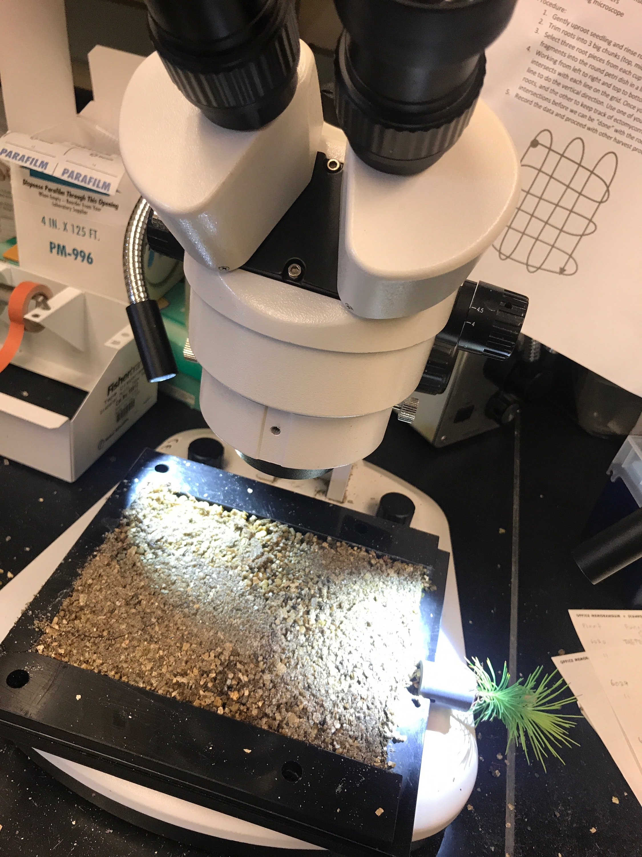
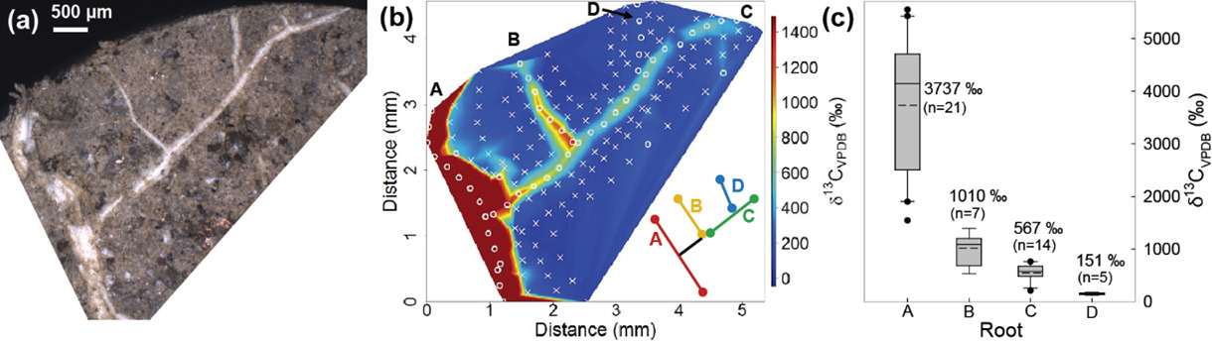
Ectomycorrhizal fungal effects on soil bacteria
Ectomycorrhizal fungi extend the root system
Do they also extend rhizosphere bacterial communities?
Track C allocation and changes in microbes with DOE
LA-IRMS
Denis et al. (2019), J Plant Nutrition and Soil Science.

Slide 51
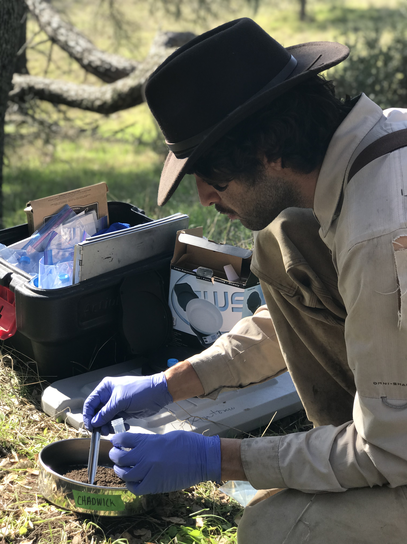
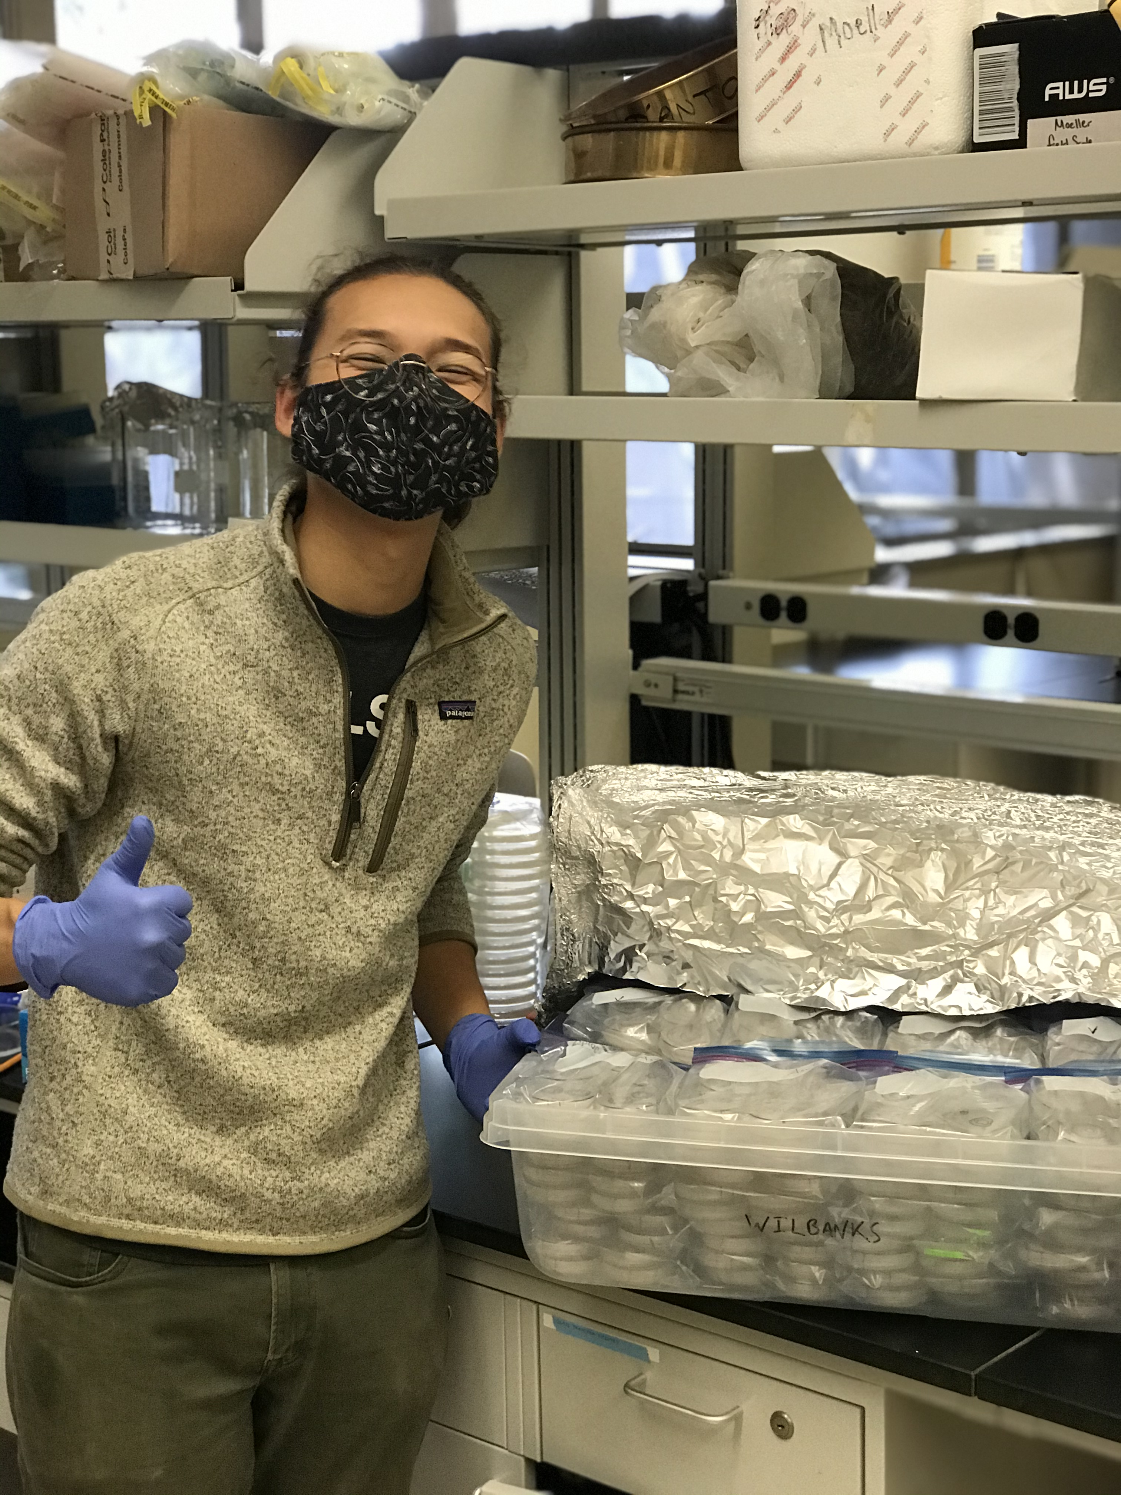
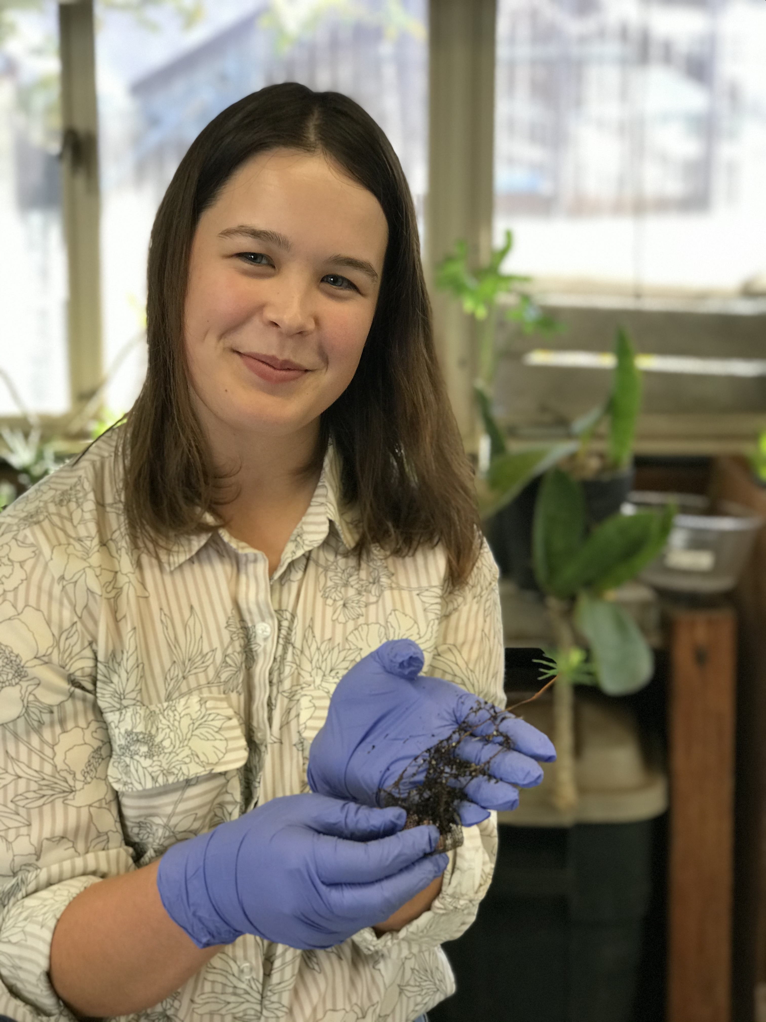
Other work in progress
Spheres of influence: Host trees affect active fungal communities (Gabe Runte)
Divergent species, convergent traits: metaanalysis of fungal communities in drought (Oceana Tavasieff)
Fungal fight club: Competitive outcomes change with pH (Alex Smith)
Molecules
Individuals
Communities
Molecules
Individuals
Communities

Slide 52
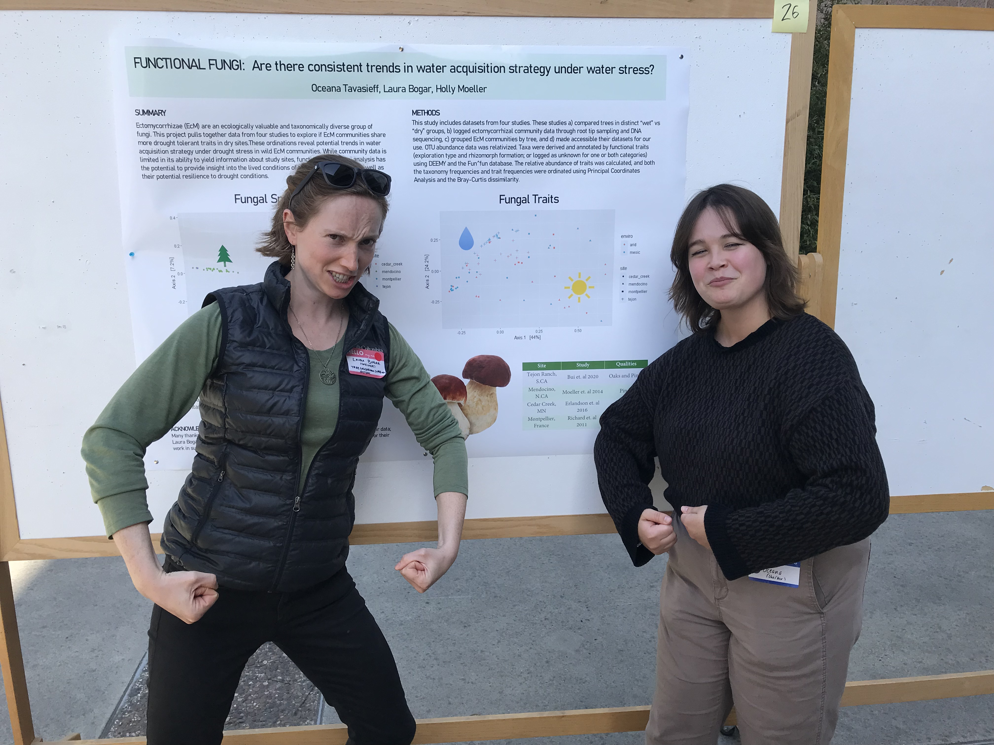

Slide 53
Future directions
Identifying a “molecular fingerprint” of plant-fungal cooperation for field characterization of symbiosis
What do fungi gain by specializing on particular plant hosts?

Slide 54

The “molecular fingerprint” of cooperation
Goal: Infer symbiotic function with straightforward molecular measurement of field-collected tissues.
Link plant gene expression in symbiotic roots with developmental stage, magnitude of C transfer, fungal growth benefit (greenhouse)
Apply lessons to field-collected mycorrhizas

Slide 55
Trade-offs in ectomycorrhizal specialization
Why aren’t all ectomycorrhizal fungi compatible with all ectomycorrhizal plants?
Investigate trade-offs with greenhouse experiments
Track C allocation to specialists in field conditions
Notes:
Denis, E. H., Ilhardt, P. D., Tucker, A. E., Huggett, N. L., Rosnow, J. J., & Moran, J. J. (2019). Spatially tracking carbon through the root-rhizosphere-soil system using laser ablation-IRMS. Journal of Plant Nutrition and Soil Science, 182(3), 401–410. https://doi.org/10.1002/jpln.201800301

Slide 56
Using microscale tools to understand macroscale outcomes in plant symbiosis
Molecules
Individuals
Communities
Notes:
So really, to understand these macroscale patterns, we need to zoom into the processeses happening at a molecular scale, between individual plants and fungi. Today I’ll take you on two deep dives:

Slide 57
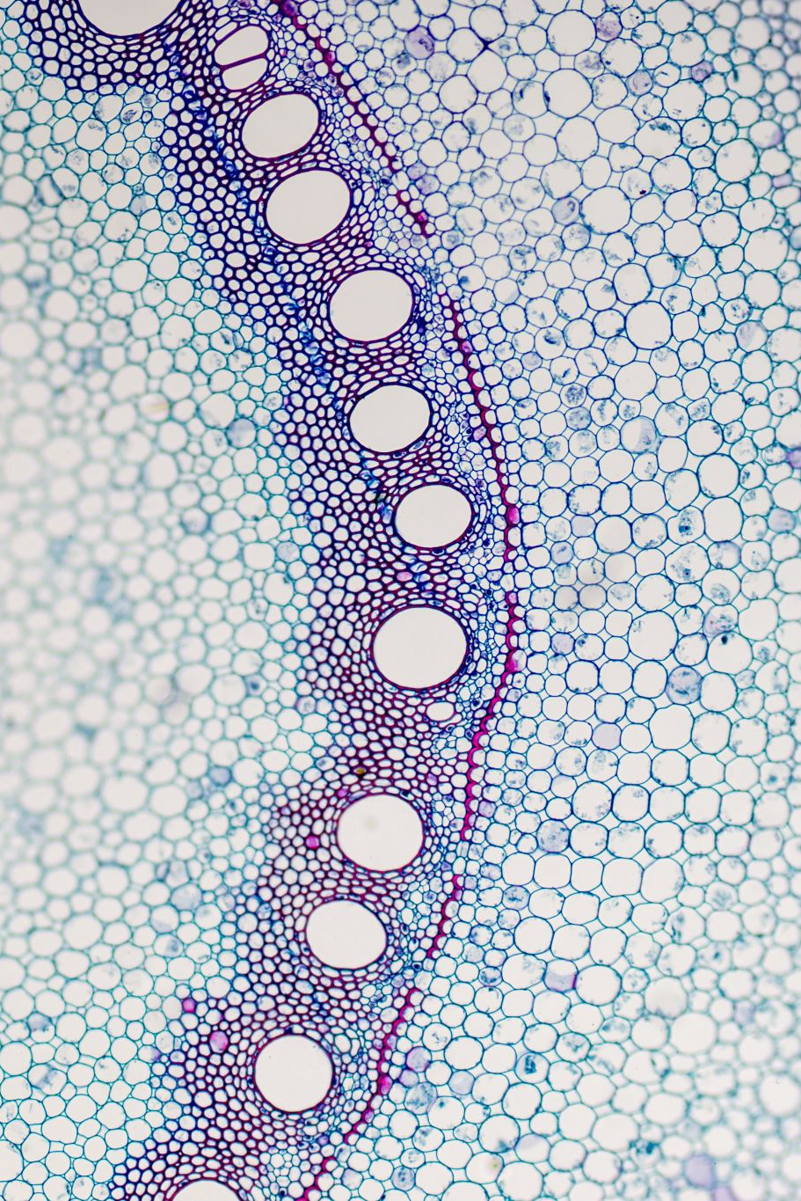
Extra slides

Slide 58
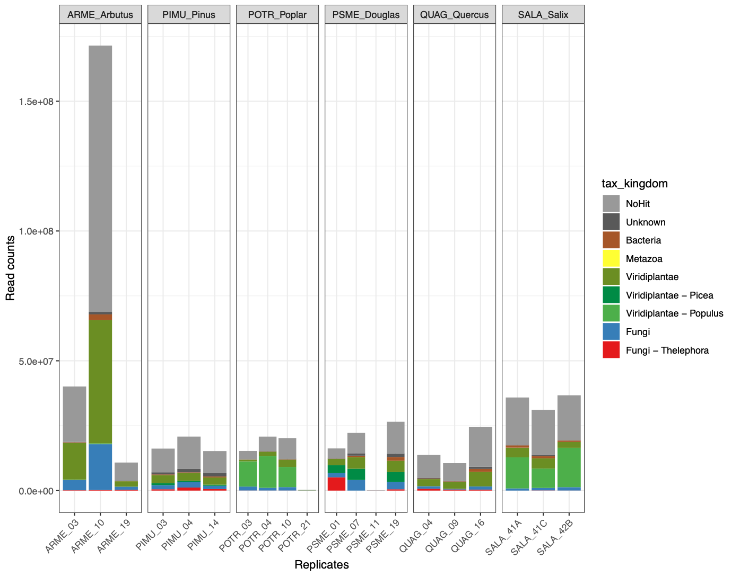
Low Tt read depth
Mycorrhizas varied in the number of Tt reads available
Had to pool many mycorrhizas for RNA extraction
Very little Tt info for most hosts; DE detectable only for Pinus and Quercus.

Slide 59
Low Tt read depth (numbers)
Symbiotic environment | Pinus muricata | Pseudo-tsuga menziesii | Salix lasio-lepis | Populus tricho-carpa | Quercus agrifolia | Arbutus menziesii |  | Thele-phora terrestris (hyphae, no host)
Total cDNA libraries analyzed | 3 | 3 | 3 | 4 | 3 | 3 | 3
Total reads (*10⁷) | 5.80 | 3.24 | 8.22 | 5.03 | 4.44 | 10.85 | 10.38
Median reads per sample (*10⁷) | 1.90 | 1.47 | 2.71 | 1.47 | 1.17 | 2.80 | 5.23
Mean % pseudo-aligned | 2.73 | 19.6 | 0.33 | 6 | 1.37 | 1.57 | 55.7

Slide 60

Is it helpful for a plant to have many fungal partners?
Examining “portfolio effects” in ectomycorrhizal seedlings

Slide 61
Environmental variability is an important challenge for trees

Slide 62
Do fungi provide different benefits?

Slide 63

Seedling stage is especially critical

Slide 64
Could having a diverse fungal “portfolio” help trees withstand variability?

Slide 65
Central questions
Do fungi provide different benefits under stress?
Do seedling populations do better with access to a diverse “portfolio” of fungi?
What fungal portfolios should trees cultivate when the environment varies?
Key assumption
Greenhouse
Simulate based on greenhouse data
Model

Slide 66
Greenhouse and modeling
One plant, one fungus seedling experiment

Slide 67
Can plant get a better “deal” on N depending on the fungus?
Expensive N
These fungi respond very differently to N levels
Best “deal” from Thelephora, esp. high N
Cheap N

Slide 68
Do the fungi vary in their trading behavior with N and competition?
Yes: mycorrhizas get more C in high N
Tt trades more label than Sp
Subtle changes with competition

Slide 69
Does plant C allocated to mycorrhizas get into hyphae?
Mycorrhizas are a good proxy for C flow to fungi
Yes

Slide 70
Did the fungus give any plant a ”better deal”?
Despite some differences in symbiotic function, Thelephora may not adjust its N pricing based on the host.
“Expensive” N
“Cheap” N
Not really. Exchange rate was similar across plants.
Pine
Douglas fir
Willow
Cottonwood
Oak
Madrone

Slide 71

Fungal diversity
Cultures and spore collections (total 12 spp.)
At least 8 independent origins of symbiosis
Many reference genomes available
Notes:
3 fungal species from spores
9 from cultures
<phylogeny image here>
At least 8 estimated independent origins of symbiotic lifestyle

Slide 72
Stresses applied
Drought
Nitrogen
Deposition

Slide 73
Measurements
Plant performance
Mass
N content
ẟ¹³C (drought proxy)
Fungal performance
Root colonization
Hyphal length
Transcriptional behavior

Slide 74
Modeling optimal seedling strategies
How much C should a tree invest in lower-quality partner, if environment might change?

Slide 75
Answers on their way!
Which fungi provide what benefits to the plant?
Do seedlings do better with access to a diverse “portfolio” of fungi?
What fungal portfolios should trees cultivate when the environment varies?

Slide 76

Portfolio effects should reduce variation in seedling performance at the population scale
Less variation = less chance population dies out completely (long time scale)

Slide 77







How does partner diversity affect seedling populations?
Measure
Simulate
2 fungi
3 fungi
... n fungi
1 fungus

